Slide 1
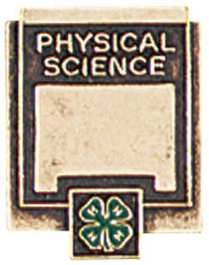
Measurement
(Chap. 1)
Notes:
Have all students measure 20 Al bars and 30 rulers.

Slide 2
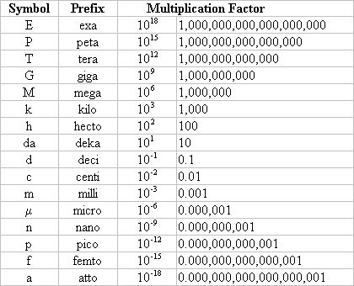
Common Metric Prefixes

Slide 3
International System of Measurement (SI)
SI units form a base-10 or decimal system.
kilo….hecto….deka….BASE….deci….centi….milli
1000 100 10 1 0.1 0.01 0.001
meter
gram
liter
example: 6,532,492cm => ?km
65.32492km
example: 0.00032kg => ?g
0.32g

Slide 4
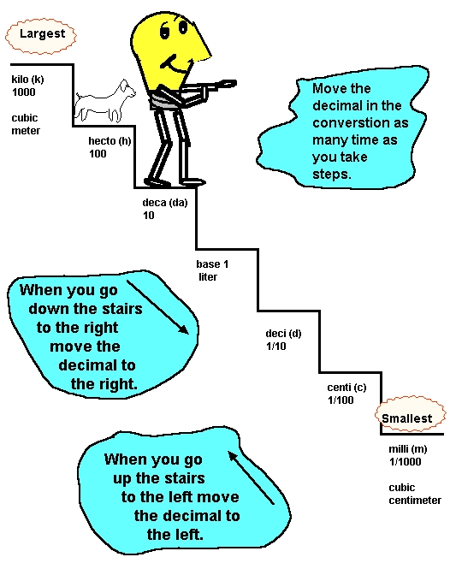

Slide 5
Measurement
Common units of measurements and equipment to use--
Mass: g, kg
  Use balance or scale
Distance: mm, cm, m, km
  Use ruler or meter stick
Volume: ml, L, cm³
  Use graduated cylinder
Temperature: ºC, ºF, Kelvin
  Use thermometer
Time: seconds, minutes, hours…..
  Use stop watch
= most common

Slide 6
Precision, Accuracy, and Resolution
Precision
  describes how close together repeated measurements or events are to one another-- even if it is wrong
Accuracy
  how close the measurement is to the correct answer
Resolution
  the smallest amount that can be measured

Slide 7
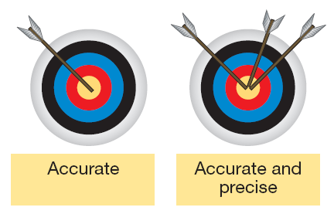

Slide 8


Slide 9
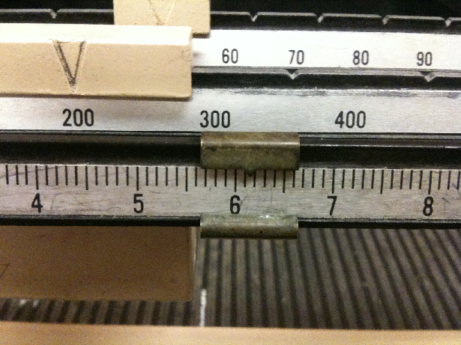
256.15 g

Slide 10
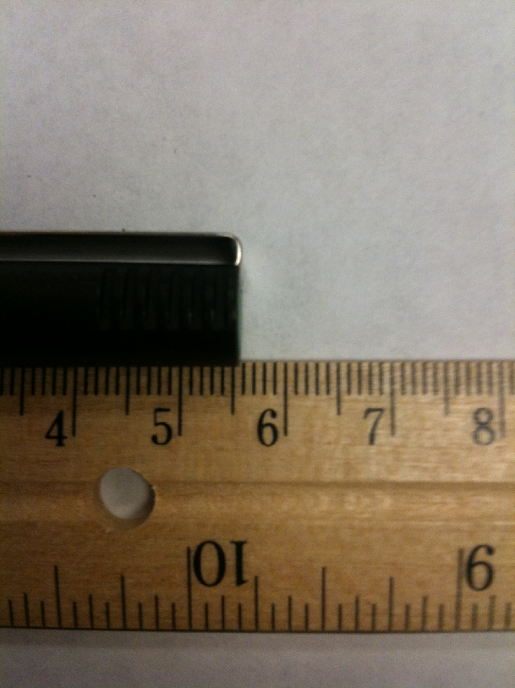
5.55 cm

Slide 11
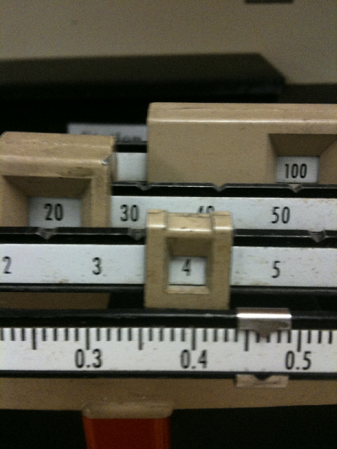
124.465 g

Slide 12
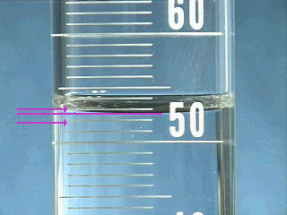
52.6 ml

Slide 13
Graphing
“MIXES TUL”
M: maximize your graph (use all of the graph paper)
IX: Independent variable on X-axis (dependent variable on y-axis)
ES: Equally Spaced scale increments (start at 0)
T: Title (descriptive and mentions the y-variable vs. x-variable)
UL: Units and Labels on both axes

Slide 14
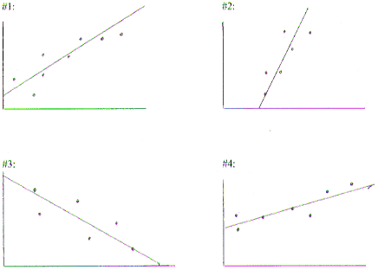
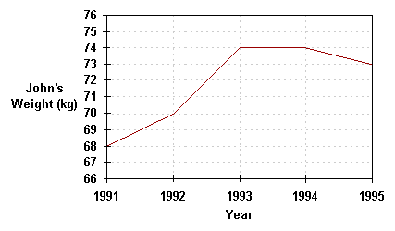
Types of Graphs
Line or scatterplot graphs
  can help determine if two variables are related
  can connect the dots or sometimes draw a line of best fit
  Often used to show changes over time

Slide 15
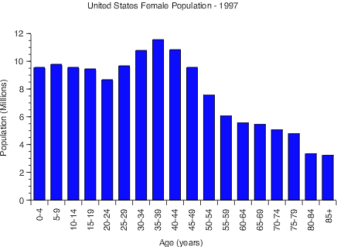
Bar Graphs
  used when you want to compare different data such as objects or events

Slide 16
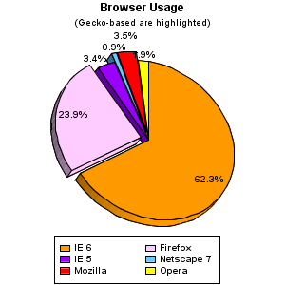
Pie Graphs
  show the amount each part makes of up of the whole (100%).

