Slide 1
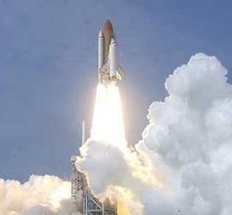
Acceleration

Slide 2
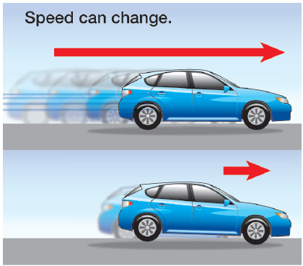
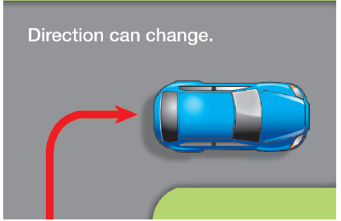
a change in velocity (speed or direction or both) over time
  speeding up or slowing down
  changing direction
    moving in a circle is always changing direction

Slide 3
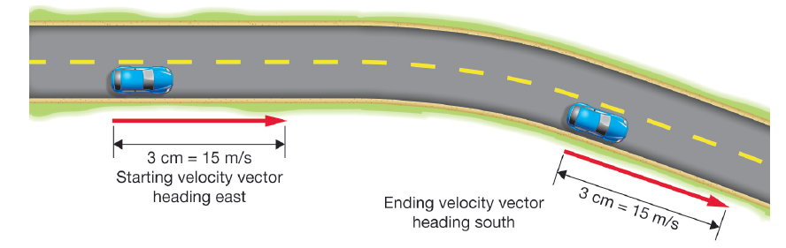

Slide 4
if acceleration is a negative number it is referred to as negative acceleration or deceleration

Slide 5
Acceleration on position-time graphs

Slide 7
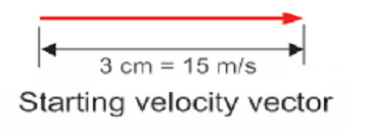
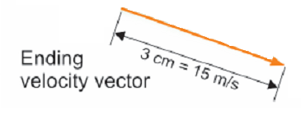
Vectors
individual vectors can be drawn to scale to calculate the change in direction

Slide 9
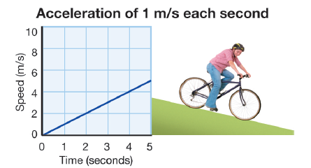
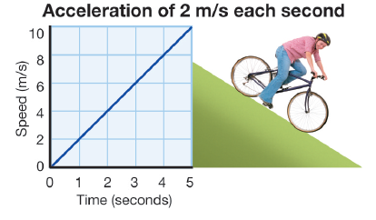
acceleration causes the line to slope up on a speed vs. time graph

Slide 10
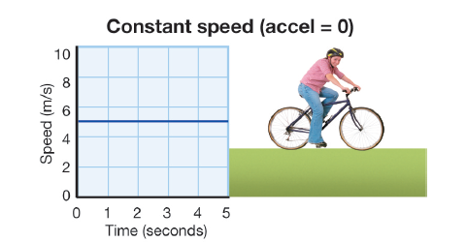
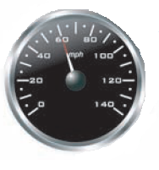
there is zero acceleration at constant speed because the speed does not change.

Slide 11
Math for Acceleration
a = v_{f} – v_{i}
t
a = acceleration
v_{f} = velocity final (speed at finish)
v_{i} = velocity initial (speed at start)
t = time

Slide 13
Example problem
A car has an initial velocity of 3.4 m/s. After 3 seconds, its final velocity is 8.2 m/s. Calculate its acceleration.
or can use m/s² which is same as m/s
^{sec}
Given formula show work answer w/ units
v_{i} = 3.4m/s a = v_{f} - v_{i}
v_{f} = 8.2m/s t
t = 3 sec.
8.2m/s – 3.4m/s
3 sec
m/s
sec
1.6

Slide 14
Example problem
A rocket is traveling 100 km/hr upwards. After 4.5 seconds, its velocity is 900 km/hr. Calculate its acceleration.
Given formula show work answer w/ units
v_{i} = 100km/hr a = v_{f} - v_{i}
v_{f} = 900km/hr t
t = 4.5 sec.
900km/hr – 100km/hr
4.5 sec
km/hr
sec
178

Slide 15
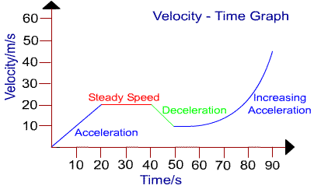

Slide 16
Free fall
an object is in free fall if it is accelerating due to the force of gravity and no other forces are acting on it

Slide 17
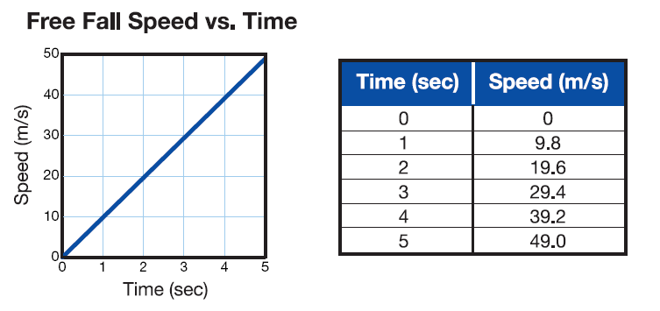
The letter “g” is used for acceleration due to gravity.
Falling objects increase their speed by 9.8 m/s every second, (9.8 m/s/s or 9.8 m/s²)

