Slide 1
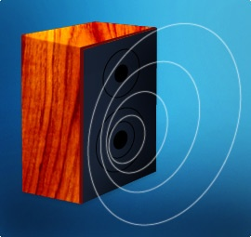
Properties and Uses of Sound

Slide 2
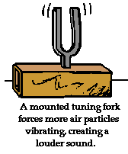
Making Sound
a longitudinal wave
produced when matter vibrates
this in turn, causes the medium in which it is in to vibrate
ex: tuning fork (the matter)
vibrates so the air (the medium)
vibrates

Slide 3
Speed of Sound
at room temp., travels about 760 mph in air
speed is determined by temperature, elasticity, and density of the medium it travels through.
higher temperature = faster sound
particles can move faster
more elastic the medium = faster sound
density varies, but often faster in denser materials
breaking the speed of sound in air creates a sonic boom

Slide 4
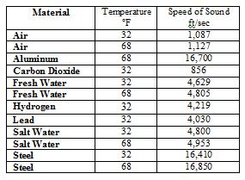

Slide 6
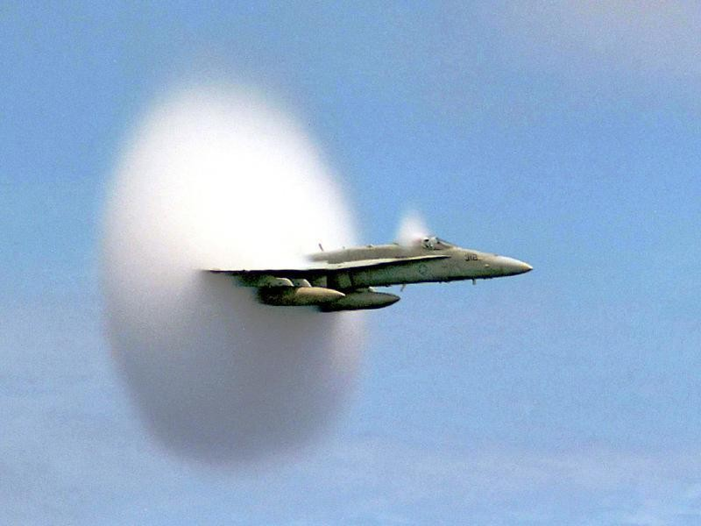

Slide 7
sonic boom videoi
(also in RealPlayer library)c

Slide 8
Speed of Sound
https://www.youtube.com/watch?v=dOoHArAzdug
https://www.youtube.com/watch?v=-OnmlxVjGhc
https://www.youtube.com/watch?v=ZyIVaZXDhho

Slide 9
How do Humans Hear Sound

Slide 10
How do Humans Hear Sound
How the Ear Works
Short hearing Test

Slide 11
Properties of Sound
1. Pitch
depends on the frequency of the wave
high frequency = high pitch
low frequency = low pitch
humans can hear sound from 20 Hz to 20,000 Hz.
infrasonic waves are below 20 Hz
moving your hand
ultrasonic waves are above 20,000 Hz
“uses” are....

Slide 12
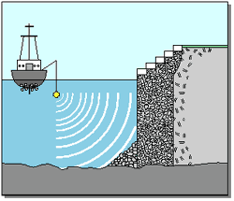
SONAR
uses ultrasonic waves in a system called SOund Navigation And Ranging
uses of SONAR
map the ocean
floor
military

Slide 13
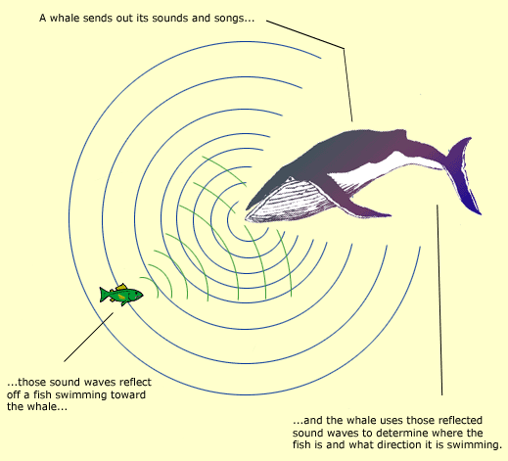
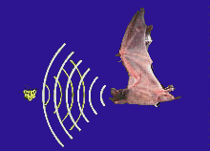
bats and whales
send out ultrasonic waves that bounce back to locate objects just like SONAR
Bats Hunting Moths

Slide 14
medical
use ultrasound waves to create sonograms
very high frequencies (1-15 million Hz)
used in medical facilities to get a picture an organ structure or fetus
can even be concentrated to destroy bad tissue

Slide 15
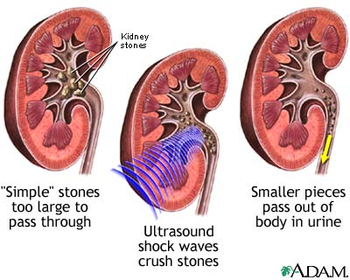

Slide 16
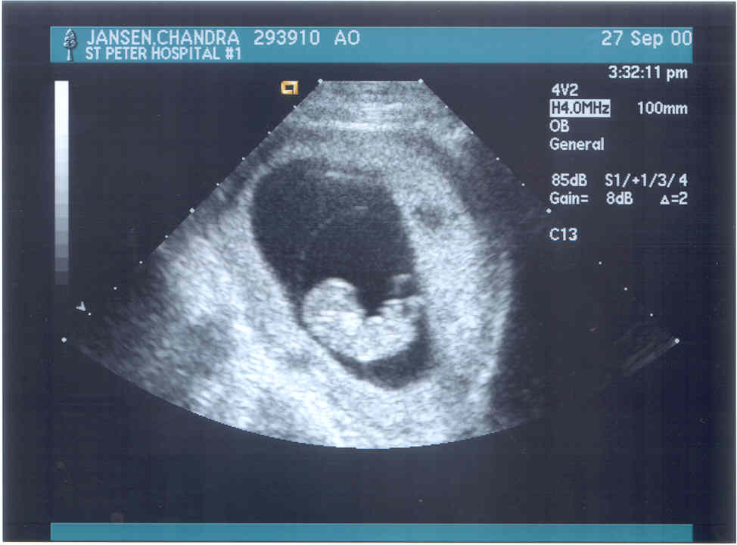
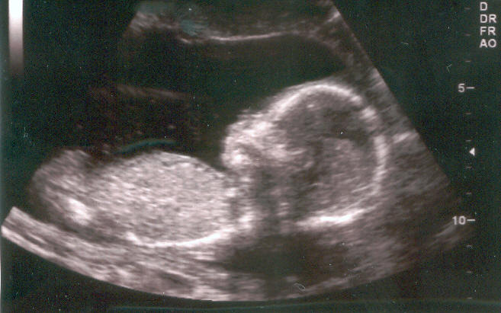

Slide 17
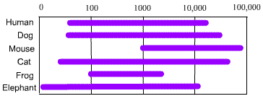
Range of frequencies or pitches that humans and various animals can hear

Slide 18
Doppler Effect
a change in pitch because there is motion between the sound and the person listening to it
moving towards you = higher pitch because waves are being compressed
moving away from you = lower pitch because waves are being spread out
Doppler Effect Animation
Horn Sound
Another Doppler Sound

Slide 19
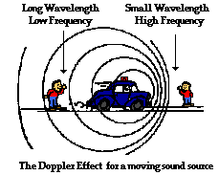

Slide 20
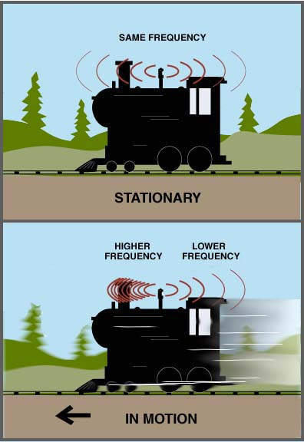

Slide 21
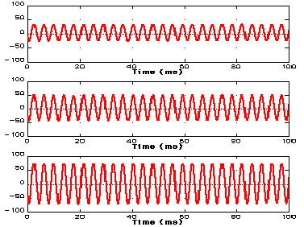
2. Intensity
amount of energy carried by the wave
the greater the compression (amplitude) the louder the sound
unit of measurement is the decibel (dB)
every 10 decibels is about twice as loud
over 100 dB could start to damage hearing

Slide 22
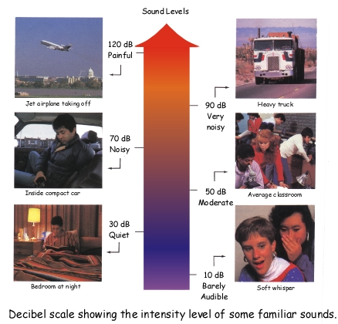

Slide 23
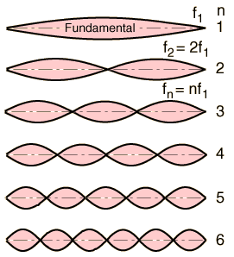
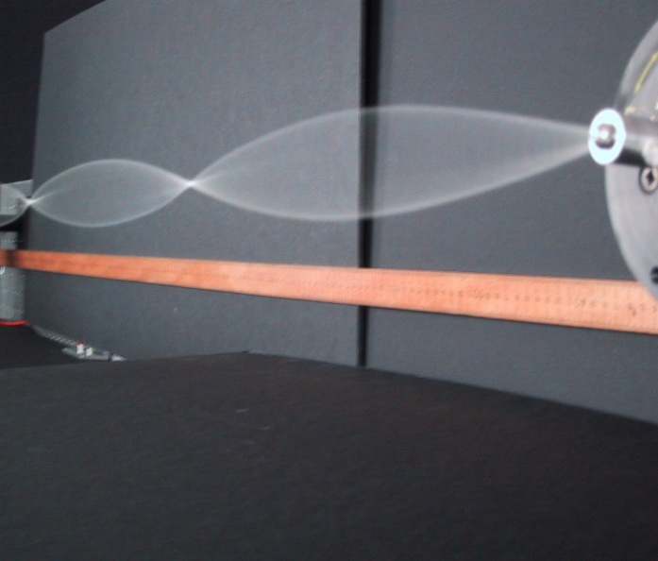
Music vs. Noise
Music
sounds that have a definite identifiable pitch, and rhythm
musical instruments use standing waves to produce sound.

Slide 24
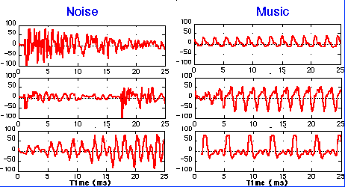
Noise
sounds that have, no identifiable pitch, and no relationship between high and low pitches
when noise reaches a level that cause pain or stress it becomes noise pollution

