Slide 1
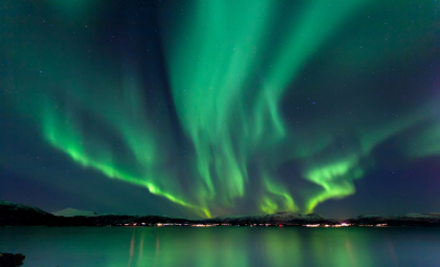
Electromagnetism

Slide 2
In 1820, it was discovered that a compass needle is affected by an electric current.
Several responses to Hans Christian Oersted's observation:
No way!!! For realz?
Liar!
Unbelievable!
He went further to propose that the direction of the field changed with the direction of the current.

Slide 3
A rule was created to predict the direction of the magnetic field.
It is called The Right Hand Rule
Field can either be clockwise or counterclockwise, depending on the direction of the current.

Slide 4
What is an ELECTROMAGNET?
A temporary magnet made by wrapping a wire coil carrying a current around an iron core.

Slide 5
Solenoid - a single wire wrapped around a cylinder
In a car or truck, the starter solenoid is part of an automobile starting system. The starter solenoid receives a large electric current from the car battery and a small electric current from the ignition switch.
When the ignition switch is turned on, the small electric current forces the starter solenoid to close a pair of heavy contacts, thus relaying the large electric current to the starter motor.

Slide 6
Properties of Electromagnets
1. Temporary, only magnetic when there is a current flow
2. Strength of the magnet is increased by adding more loops of the wire around the cylinder
3. It still has a north and a south pole
4. Attracts other magnetic materials
5. When current is turned on, the magnet may be attracted (or repelled) to other magnets. The movement can then be converted to mechanical energy to work
Examples:
Stereo speakers
Electric motors
Telephones

Slide 7
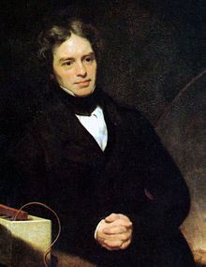
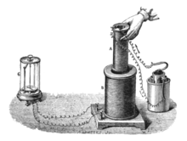
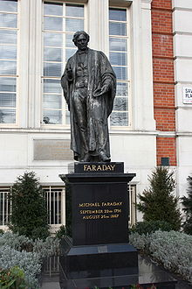
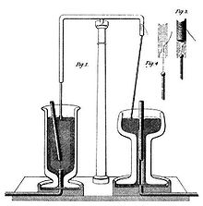
Faraday’s Law
Michael Faraday – 1791 to 1867
- English physicist and chemist
The Law:
Any change in the magnetic environment of a coil of wire will cause a voltage to be "induced" in the coil.
No matter how the change is produced, the voltage will be generated.
The change could be produced by changing the magnetic field strength, moving a magnet toward or away from the coil, moving the coil into or out of the magnetic field, rotating the coil relative to the magnet, etc.

Slide 8
What is an electric motor?
Device that changes electrical energy into mechanical energy - causing something to move:
-- blades of a fan
-- wheels of a car
-- hair dryers
-- blenders
http://www.sparkmuseum.com/MOTORS.HTM

Slide 9
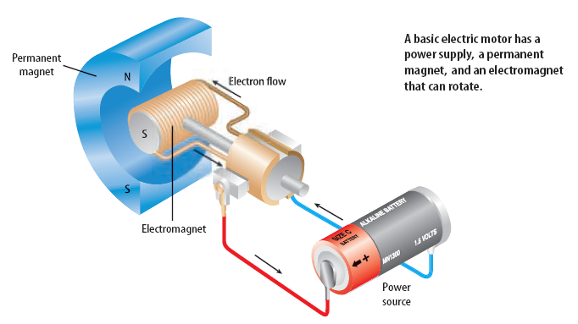
How do electric motors work?
An electric motor is a device which changes electrical energy into mechanical energy.

Slide 10
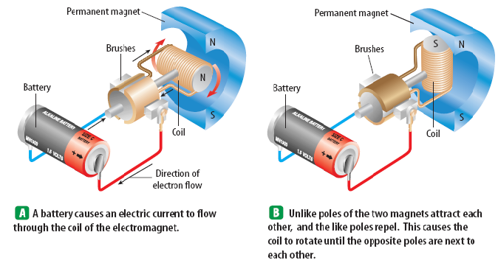
How does an electric motor work?
Go to the next slide →

Slide 11
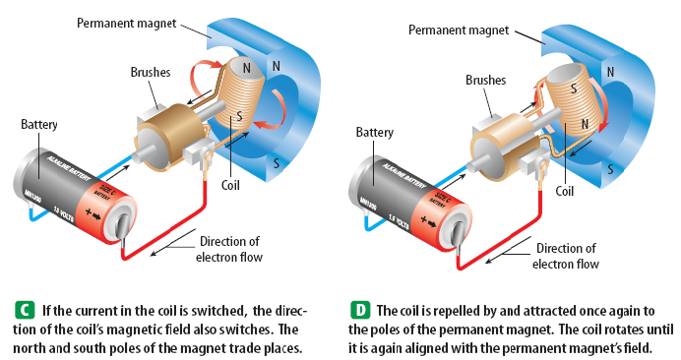
Simple as that!!

Slide 12
What is a GENERATOR?
Converts mechanical energy to electrical energy

Slide 13
We have seen how electricity can produce a magnetic field, but a magnetic field can also produce electricity! How?
What is electromagnetic induction?
Moving a loop of wire through a magnetic field produces an electric current. This is electromagnetic induction.
A generator is used to convert mechanical energy into electrical energy by electromagnetic induction.
Carefully study the next diagrams:

Slide 14
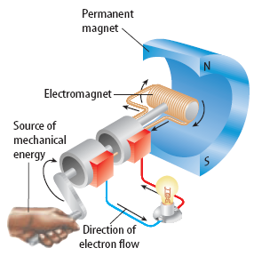
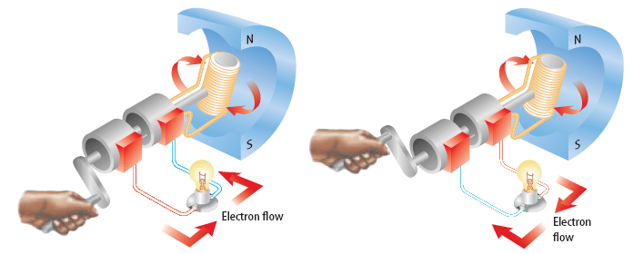

Slide 15
Magnets Can be Used to Move Objects
When you turn off the power, the magnet stops working (and you can drop the object)

Slide 16
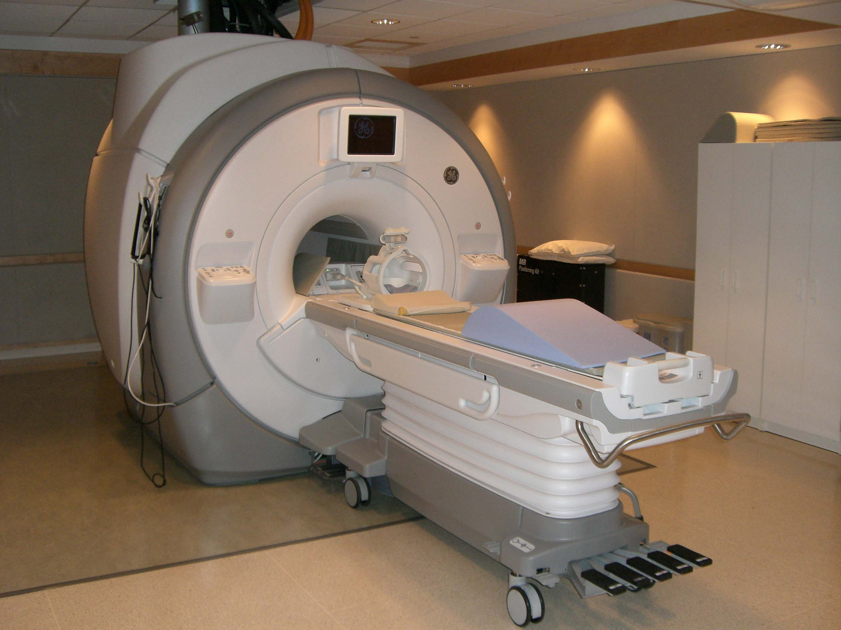
MRI machines

Slide 17
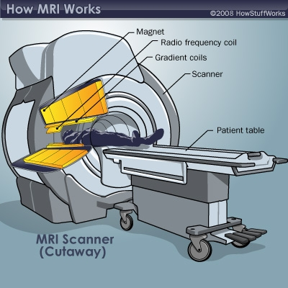
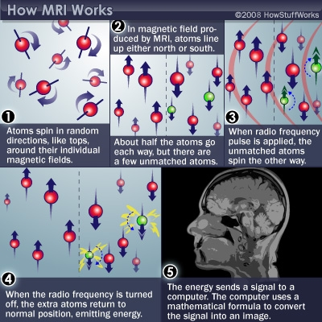
© 2008 HowStuffWorks.com

Slide 18
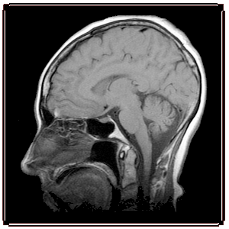
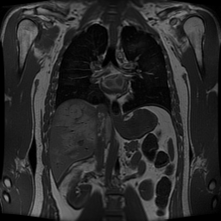

Slide 19
Maglev Trains
Magnetic + Levitation = maglev
Maglev vehicles “float” over an electromagnetically powered fixed steel guideway and are propelled by the current with no motors, wheels, moving parts or additional energy sources. The system is environmentally friendly, energy efficient and runs in all weather conditions.
http://dsc.discovery.com/videos/extreme-engineering-season-1-shorts-maglev-train.html

Slide 20
What is a transformer?
A device that increases or decreases the voltage of an AC current.

Slide 21
1. All magnets are surrounded by an invisible force called the ________________ _______________ 2. The north pole of one magnet will be attracted to the ______ pole of another magnet. 3. The poles of the earth can move. True or False? 4. In the far north, radiation from the sun is reflected off the earth's magnetic field and creates patterns of colors. This effect is known as the ___________ ________________ 5. A nail is normally not magnetized. How can you magnetize it?

Slide 22
6. Who discovered that magnets are affected by electricity? 7. You can make an ______________________ by wrapping a wire coil carrying a current around an iron core. 8. What car part is attached to your starter and is needed to start the car? 9. A generator converts ___________ energy into electrical energy.

