Slide 1
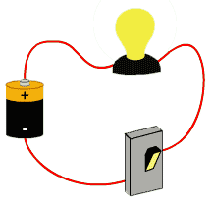
Electricity

Slide 2
Charge
whether two charges attract or repel depends on whether they have the same or opposite sign
unit of measurement for charge is the coulomb (C)
  one electron has a charge of 0.00000000000000000016 coulombs

Slide 3
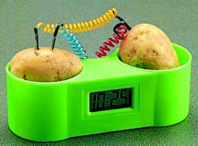
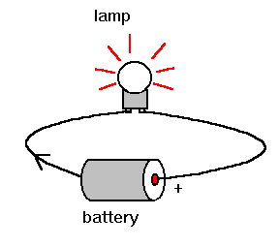
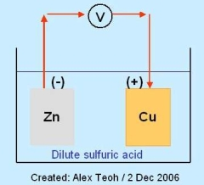
Current Electricity - Circuits
Electric Current - Flow of electrons through a material
Electrical Potential – like chemical potential energy
  Similar to potential energy (lifting something higher against the force of gravity gives it greater potential to do work, increasing its potential energy.)
  When given the opportunity, objects will move from higher potential energy to an area of lower potential energy
  Electrical potential is related to their electrical fields and not to height – as electrons build up on one side they “want” to flow to an area w/ less potential

Slide 4
Making Electrons Move
Electrons are need to be moved by a device.
The device uses some form of energy to do the work to move the electrons.
These devices include…
Batteries
Generators
Photo Cells
Thermocouples

Slide 5
A useful analogy to help understand these terms is a system of plumbing pipes.
Voltage = Water Pressure
Current = Flow Rate
Resistance = Pipe Size or Diameter

Slide 7
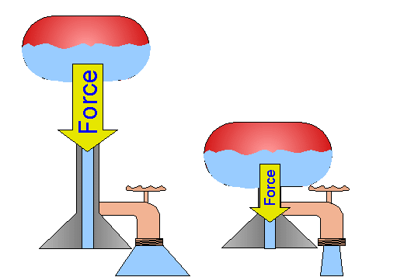
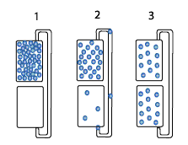
Voltage
a measure of electric potential energy
voltage is an electrical force
  measured in volts (V)
a difference in voltage provides the energy that causes current to flow

Slide 8
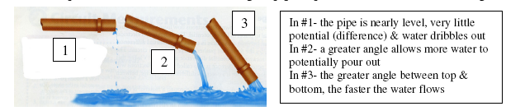
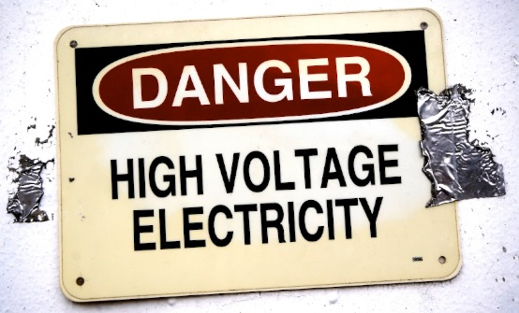
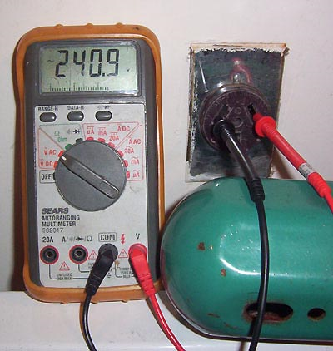
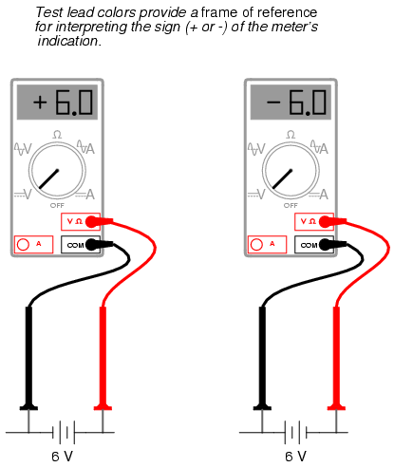
Voltage
A Voltage Source (battery or generator) is required to maintain the electrical potential in a circuit.

Slide 9
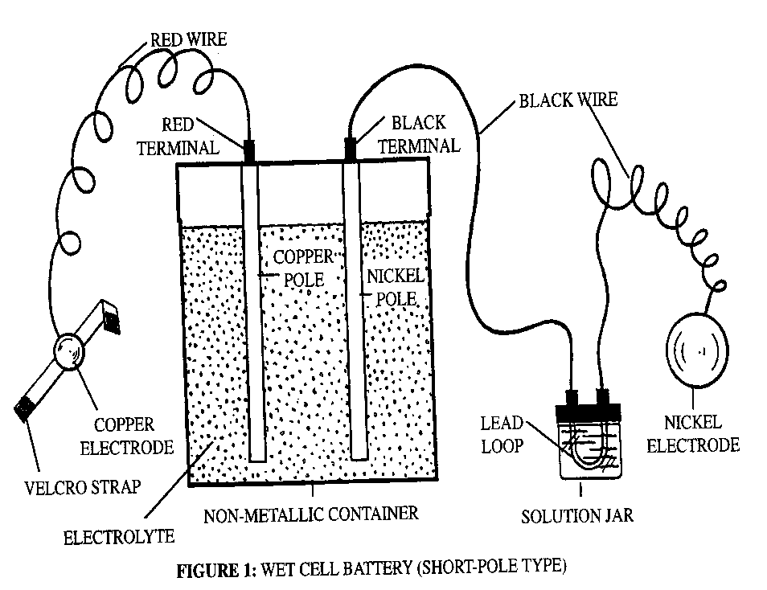
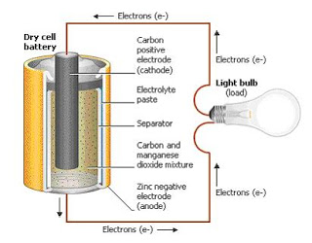
Two Types of Batteries
Wet Cell
Dry Cell

Slide 10
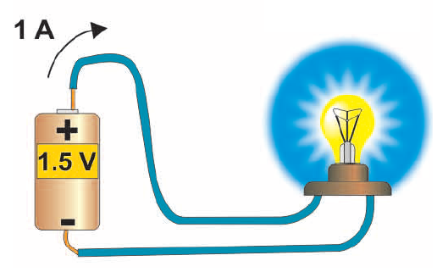
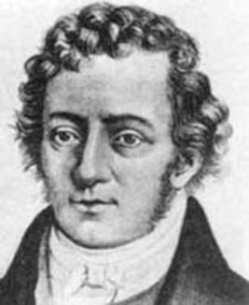
Electrical Current
comes from the motion of electrons
is the rate at which electrons flow past a point on a circuit
  measured in units called amperes, or amps (A)
current

Slide 11
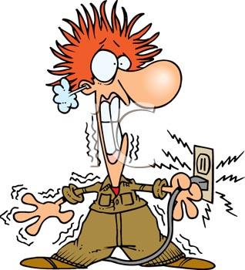
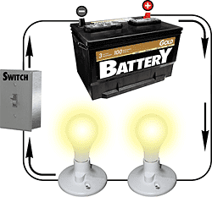
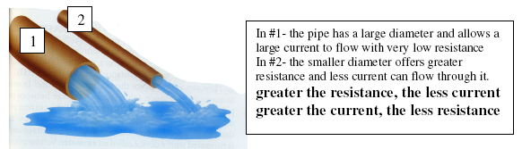
Electrical Current
Water flowing thru a pipe depends on more than the angle of the pipe or pressure (voltage). It also depends on the length of the pipe, diameter of the pipe and if the pipe is clogged or open (current).
Amount of Electrical Current ( amps) depends on more than just Voltage, it depends on the Resistance found in the circuit.
“Not the volts that will get you, it’s the amps!”

Slide 12
There are 2 types of Currents:
1. Direct Current (DC) – Where electrons flow in the same direction in a wire.
EX: Batteries
Thomas Edison

Slide 13
There are 2 types of currents:
2. Alternating Current (AC) – electrons flow in different directions in a wire
EX: Power from your wall receptacle
Inventor: Nikola Tesla

Slide 14
Tesla and Edison – 9:00
DC vs AC Power
  Battle between Edison and Tesla for standard system of power in America.

Slide 15
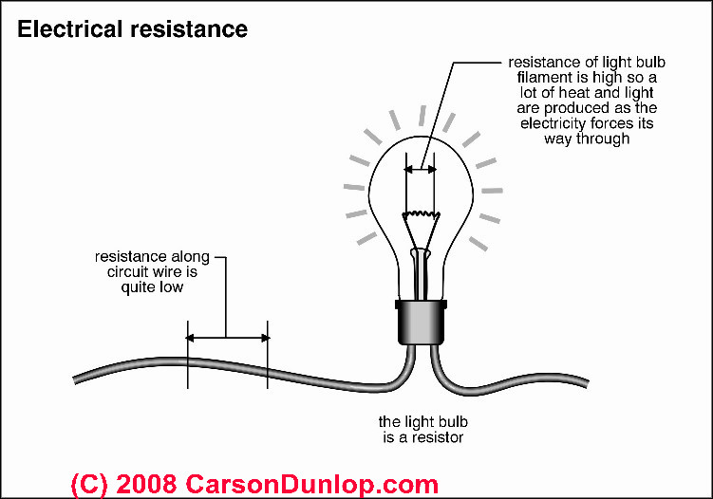
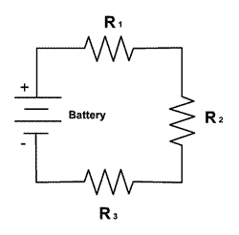
Resistance
the resistance to the flow of electrical current
  measured in ohms
the resistance of electricity creates heat

Slide 16

Electrical Resistance
the opposition to the flow of electricity –
measured in Ohms – symbol is the Greek letter Omega -
Water flowing thru a pipe depends on more than the angle of the pipe. It also depends on the length of the pipe, diameter of the pipe and if the pipe is clogged or open.
Electricity will take the path of least resistance
The greater the resistance, the less current there is for a given voltage.
  a. Longer wires have greater resistance than short wires
  b. Thin wires have more resistance than thick wire
  c. High conductors have less resistance than insulators

Slide 17
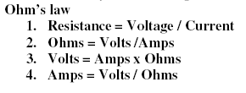
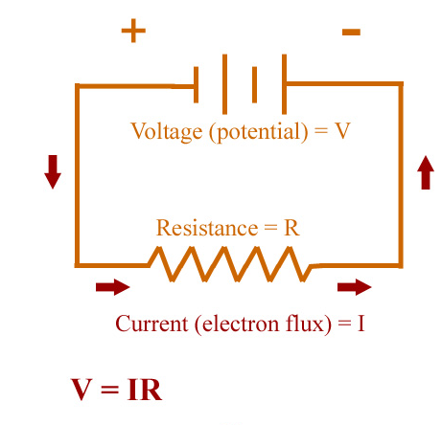
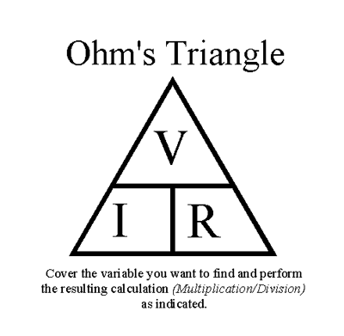
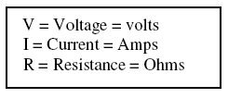
Ohm’s Law

Slide 18
Circuits
current only flows when there is a complete and unbroken path, or a closed circuit

Slide 19
series circuit
  current can only take one path, so the current is the same at all points in the circuit

Slide 20
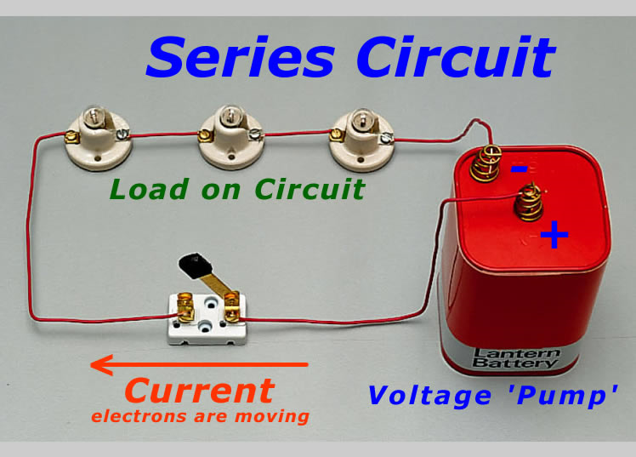
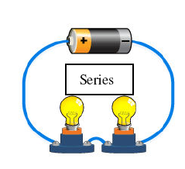
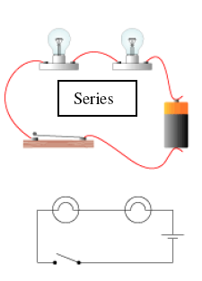
Series Circuits
Series Circuits – provides only one path for the electrons to follow
  1. A break in the circuit stops the flow of electricity to all other parts of the circuit
  2. With multiple light bulbs (more resistance) the current reduces & the dimmer the lights become
  3. Ammeters should be wired in series

Slide 21
parallel circuit
  the current can take more than one path
  each branch works independently

Slide 22
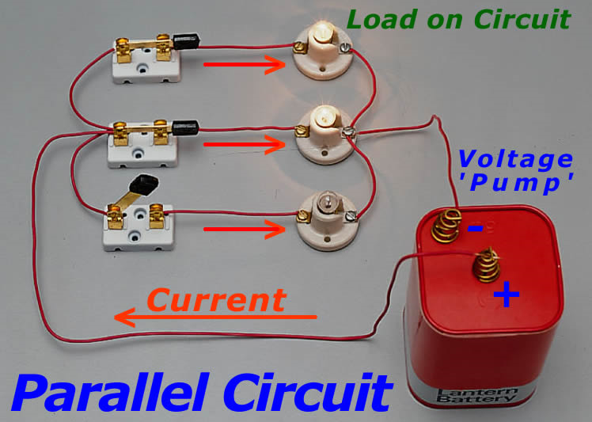
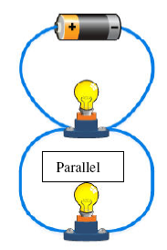
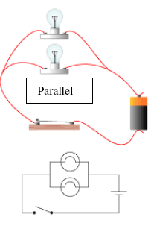
Parallel Circuits
Parallel circuits – the different parts of the circuit are on separate branches
A break (burn out light bulb) in the circuit doesn’t stop the flow to the remaining devices
Multiple light bulbs will remain the same brightness since the resistance is not decreasing as it does in a series circuit.
Each pathway can be separately switched off w/out affecting the others
Household circuits – Wired in parallel, with a standard of 120 volts
Voltmeters are wired in parallel

Slide 23
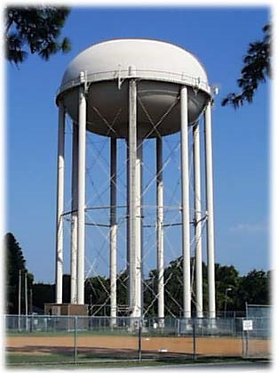
Parallel Circuits
The more paths the LESS the resistance
  Water example again: added pipes coming from a large tank will allow more water to flow out than a single pipe.
  Therefore as resistance degreases, current increases; they are inversely proportional

Slide 24
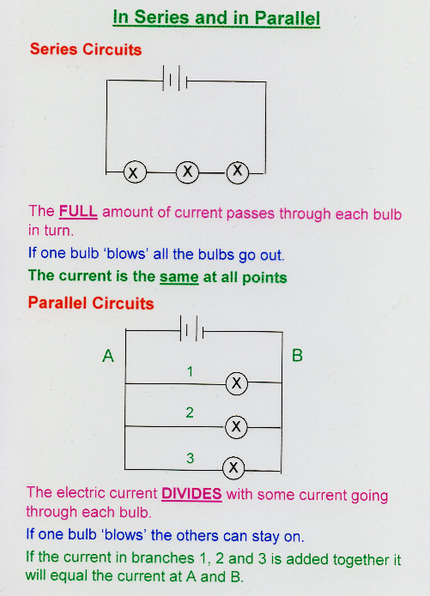
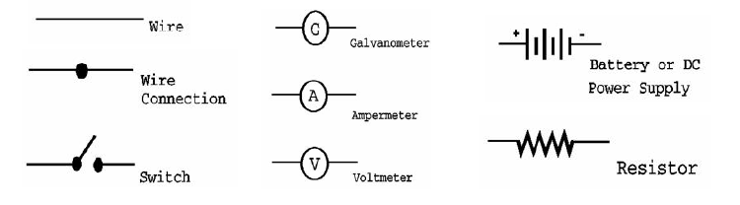
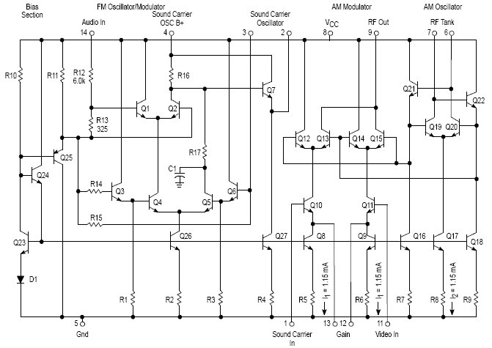
Schematic Diagrams
All circuits need at least the following
  Power supply, wire, resistors, other items include switches, connectors, meters, etc.
There is a set of standard symbols used to represent these items in a diagram of the circuit

