Slide 1
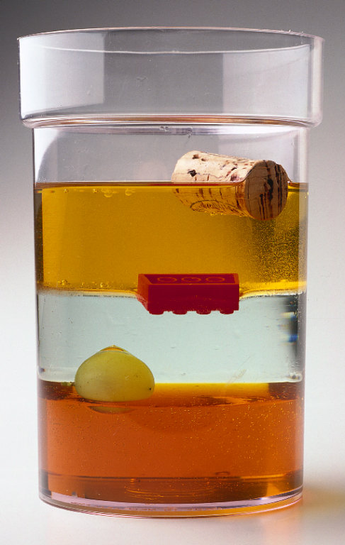
Properties of Matter and Density

Slide 2
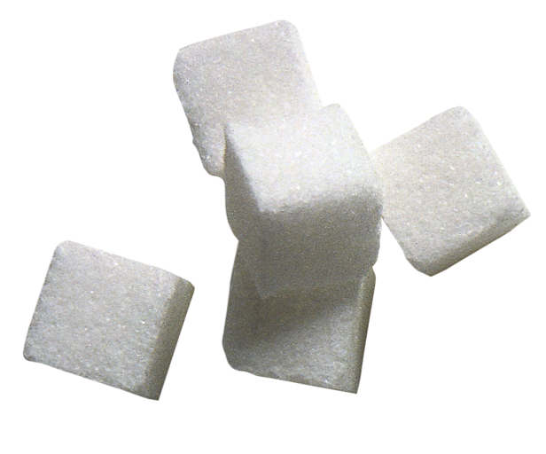
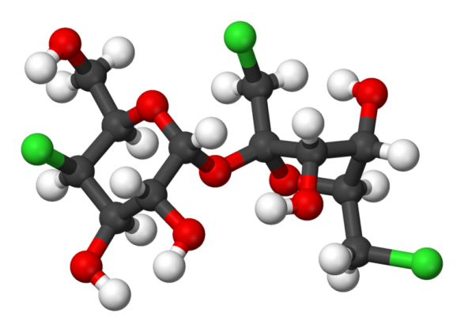
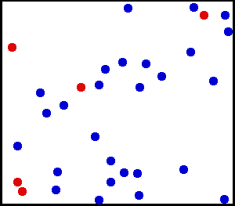
Matter
is made up of tiny particles called atoms
first evidence for atoms was called Brownian motion for Robert Brown, who first noticed the jerky motion of pollen grains in water

Slide 3
properties of ALL matter:
  mass: amount of matter (atoms) in an object
  volume: amount of space an object takes up
  density: the mass per unit volume of an object
    Back to the Future “Your are my density” clip

Slide 4
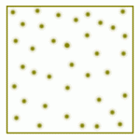
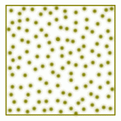

Slide 6
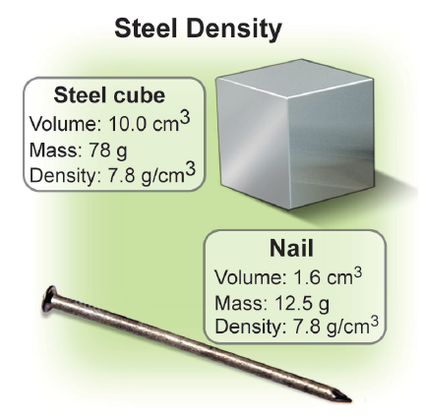
  density is a property of material independent of quantity or shape

Slide 7
Density
D = M/V
D = density
M = mass
V = volume

Slide 8
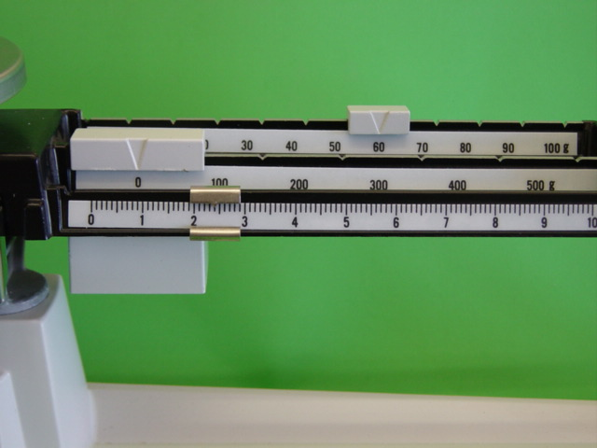
62.40 g

Slide 9
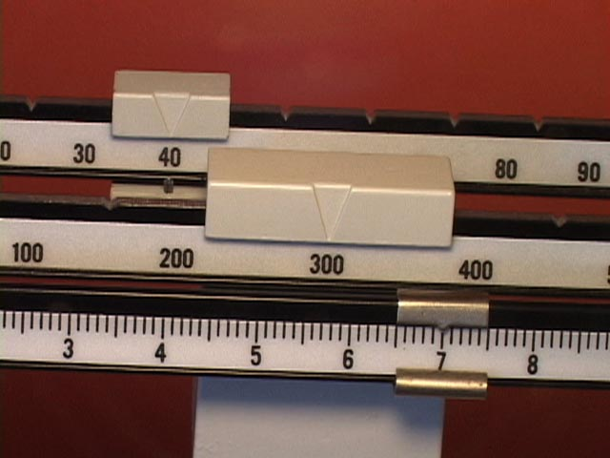
347.01 g

Slide 10
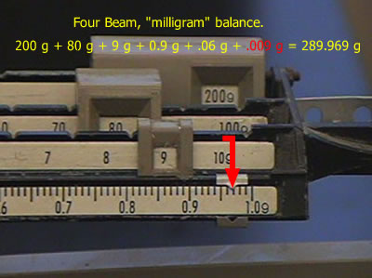
289.968 g

Slide 11
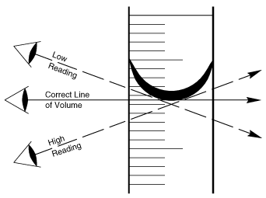

Slide 12
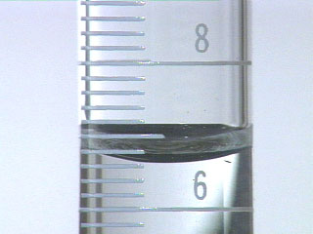
6.62 ml

Slide 13
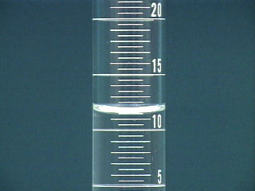
11.51 ml

Slide 14
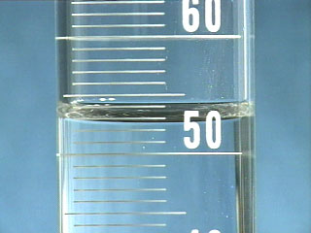
52.7 ml

Slide 15
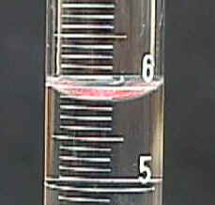
5.88 ml

Slide 16
Example problem
A 56.42 g piece of lead has a volume of 5.0 ml. Calculate its density.
given formula set up problem answer w/ unit of measurement
M= 56.42 g D=M/V
V= 5.0 ml
56.42g/5.0ml
11.3
g/ml
ml is same as cm³ so sometimes see g/cm³

Slide 17
Example problem
A ??? g piece of lead has a volume of ?? ml. Calculate its density.
given formula set up problem answer w/ unit of measurement
M= 118.05 g D=M/V
V= 10.4 ml
118.05 g/10.4ml
11.35
g/ml
ml is same as cm³ so sometimes see g/cm³
Notes:
Have students see picture next slide for mass and pass around 8 grad cyl with 10.4 ml of water in them.

Slide 18
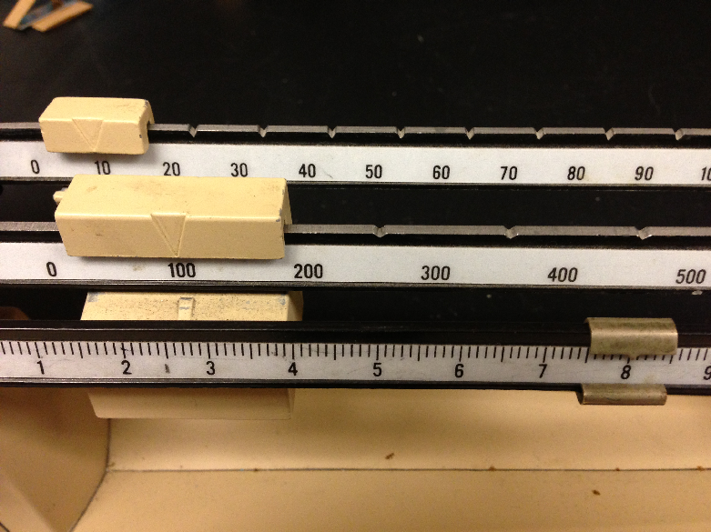

Slide 19
properties of SOME, but not all matter are:
  boiling point
  melting point
  flammability
  color of flame when burned
  solubility in water or other liquids
  color
  smell
  shape (on a molecular left, think of crystals)
  reactivity with other chemicals
  conductivity of electricity or heat

