Slide 1
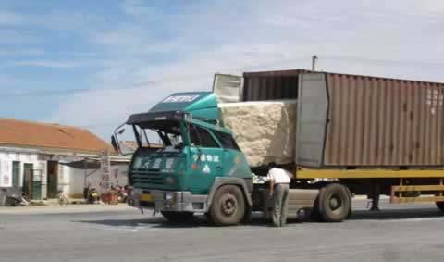
Momentum
http://phet.colorado.edu/en/simulation/forces-1d

Slide 2
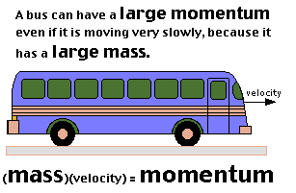
a property of any moving object that depends on its mass and velocity (or speed if you don’t worry about direction)
must know both of these in order to calculate momentum
normally we will use g(m/s) or kg(m/s) as a unit of measurement
Bill Nye 2:06

Slide 3
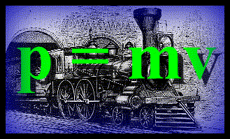
Momentum formula
ρ = mv or ρ = m·v
or ρ = m ^{x} v or ρ = m(v)
ρ = momentum
m = mass
v = velocity

Slide 5
Example problem
A ball has a mass of 2.5 kg and a velocity of 6.0 m/s heading North. Calculate its momentum.
given formula set up problem answer w/ unit of measurement
m=2.5kg p=mv
v=6.0m/s
2.5kg(6.0m/s)
15.0 kg(m/s)
How would you label the answer if the mass was
2.5 g and the velocity 6.0 km/hr?
15.0 g(km/hr)

Slide 6
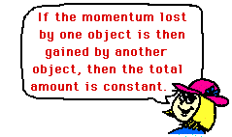
Conservation of momentum
the momentum of an object can not disappear
in a collision:
some or all of the momentum from the 1st object is transferred to the 2nd object
the momentum before and after is the same
(friction may take away some energy)
Phet - collisions

Slide 7
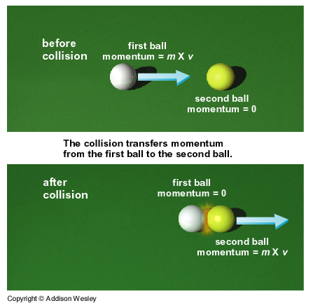

Slide 8
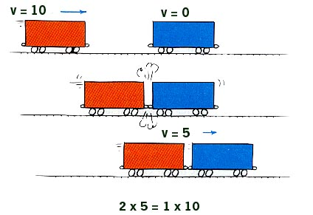

Slide 9
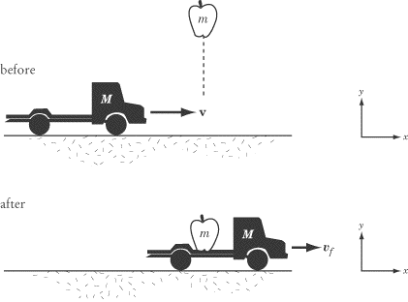
Conservation of Momentum video (1:37)

Slide 11
Evelyn White: Is it true the Titanic would have survived if it had hit the iceberg head on instead of trying to avoid it and spreading the damage so far down the side of the ship? Douglas Carson: The answer is probably yes. The Titanic was built with a system of watertight compartments and these would probably have saved the ship if only the forward compartments had rudders. But if you see an iceberg in front of you and you have two thousand people on board, your natural instinct is to try and avoid the iceberg. It would have taken a very strong man with great powers of decision to drive the Titanic at almost full speed into an iceberg. Even with the engines in reverse the Titanic had tremendous momentum. An officer who took that decision would probably have had a hard time explaining it his captain and to the inquiry.
Crazy kid youtube

