Slide 1
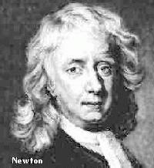
Newton’s Laws of Motion
Sir Isaac Newton Scientist and Mathematician
1642 - 1727
If I have been able to see further, it was only because I stood on the shoulders of giants.

Slide 2
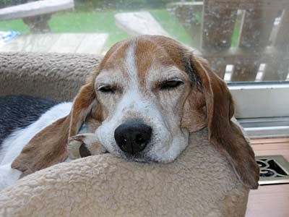
First Law of Motion
This is also known as the Law of Inertia
objects in motion will remain in motion unless acted upon by an unbalanced force
objects at rest will remain at rest unless acted upon by an unbalanced force
or put another way-- objects "tend to keep on doing what they're doing."

Slide 3
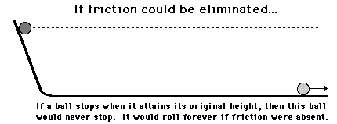

Slide 5
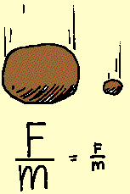

Slide 7
Second Law of Motion
explains how force, mass, and acceleration are related
if you know 2 out of the 3 (F, m, or a)-- then you can calculate the rest.
if you place a force on an object, it will accelerate in the direction you push/pull it
this acceleration is directly proportional to the force
this means if you push it twice as hard, it will accelerate twice as fast
this acceleration is inversely proportional to the mass of the object
this means if you use the same force to push a object with twice the mass of a smaller object it will accelerate half as fast

Slide 8
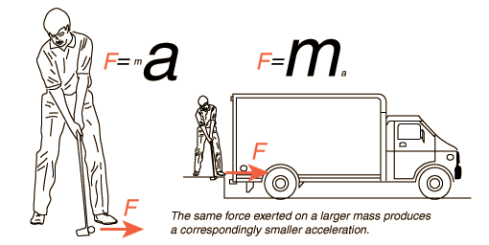

Slide 9
Formula for Newton’s Second Law
F = m a
F = Force
m = mass
a = acceleration

Slide 10
Example problem
A 3.5 kg rocket applies 10.5 N of force. What is the rocket’s acceleration?
given formula set up problem answer w/ unit of measurement
m=3.5kg a=F/m
F=10.5 N
10.5N/3.5kg
3.0 m/s²

Slide 11
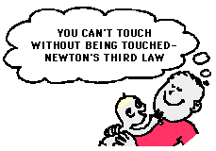
Third Law of Motion
for every action, there is an equal and opposite reaction
all forces come in pairs
in order to move, you must “push off” from something.

Slide 12
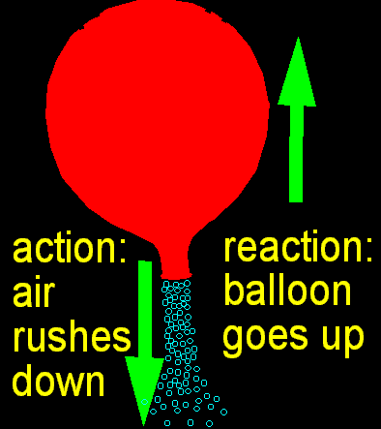

Slide 13
