Slide 1
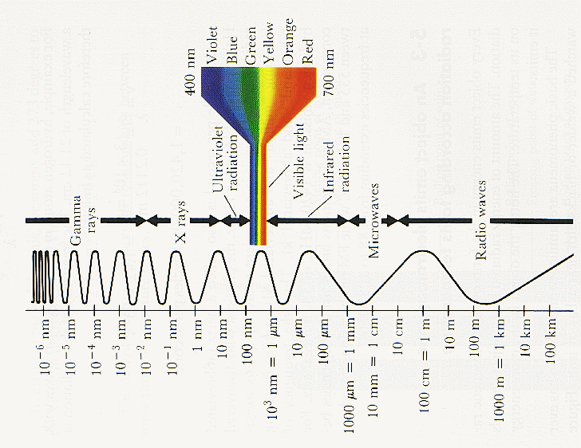
Electromagnetic Spectrum

Slide 2
What kind of wave is electromagnetic radiation?
A sound wave is a oscillation of air.
A water wave is an oscillation of the surface of water.
An oscillation of electricity or magnetism creates electromagnetic waves.
462 trillion/sec

Slide 3
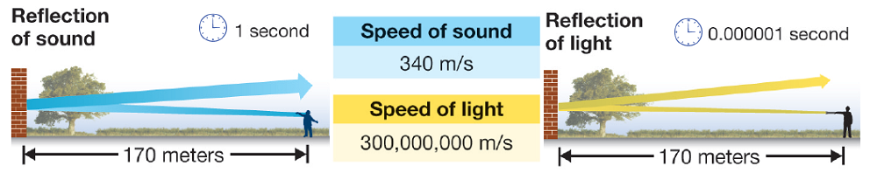
transverse waves
consists of an electric force field and magnetic force field at right angles to each other
photons (bundles of energy) act like waves AND particles.
matter does not vibrate (photons don’t need a medium)
speed is 300,000,000 m/s in a vacuum (the speed of light)
  this is the “c” in E=mc²

Slide 4
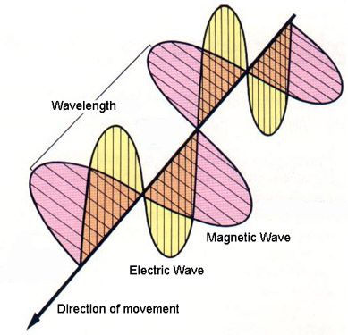
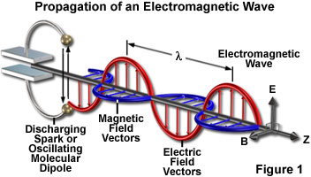
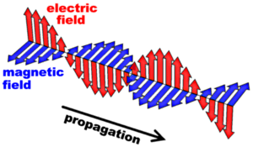
EM Wave Link

Slide 5
The Spectrum
EM waves are arranged in order based on their wavelength, energy, and frequency
  long wavelength = low frequency = less energy
  short wavelength = high frequency = more energy

Slide 6
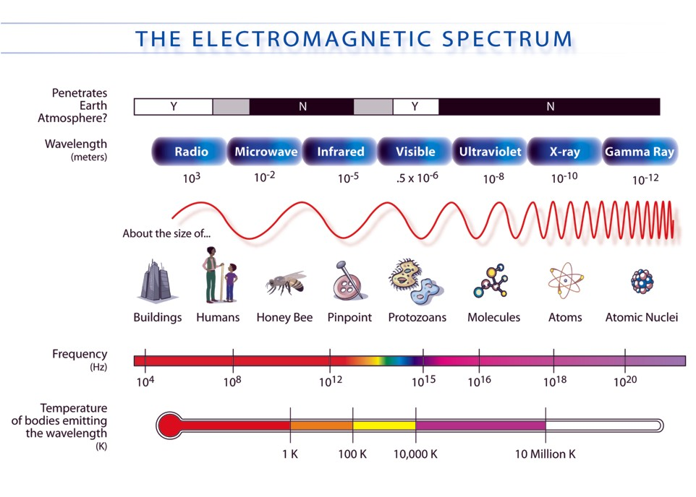

Slide 7
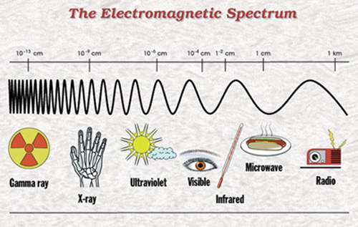

Slide 8
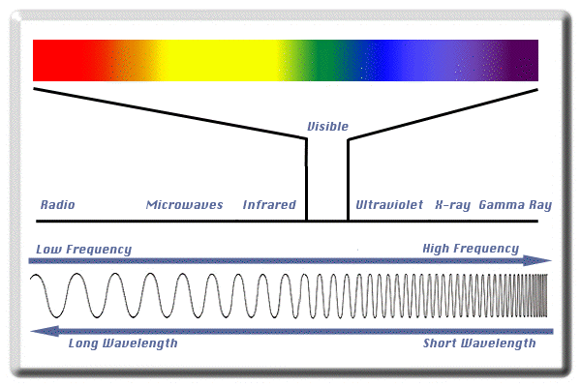

Slide 9
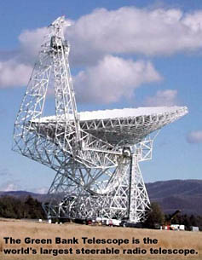
Regions of the Spectrum
EM Radiation NASA video (Intro is 5:03. All of it is 30+ min)
Radio Waves (λ = 100m-10cm)
  low energy
  made from charged particles move back and forth in antennas
  communication, AM, FM, TV (not cable)

Slide 10
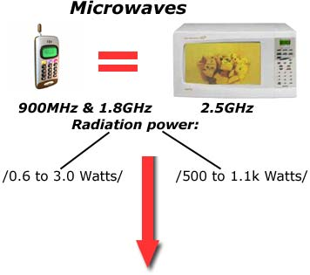
Microwaves (λ = 10cm-1mm)
  some substances absorb energy from microwaves and therefore heat up
  communication: cell phones
  RADAR

Slide 11
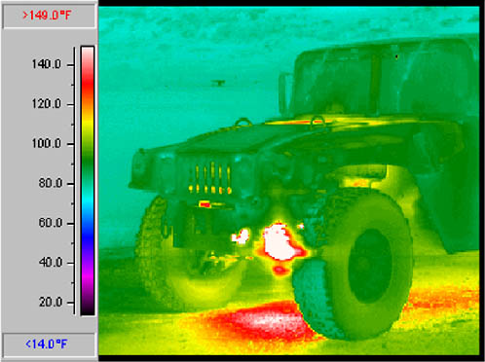
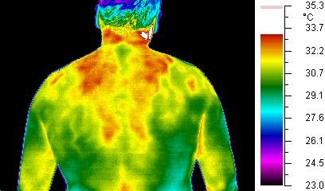
Infrared (λ = 1mm – 0.1mm)
  heat
  all objects give off some infrared rays
  remote controls

Slide 12
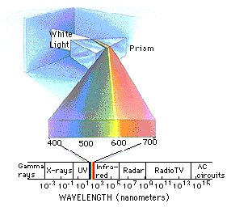
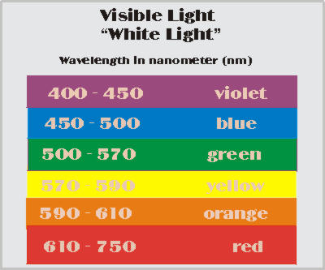
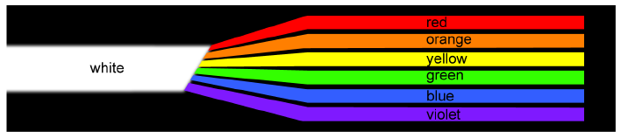
Visible Light (λ = 700nm-400nm)
  humans (and some other animals) can see
  R.O.Y.G.B.I.V. = white light

Slide 13
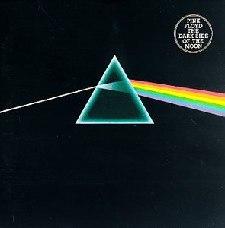

Slide 14
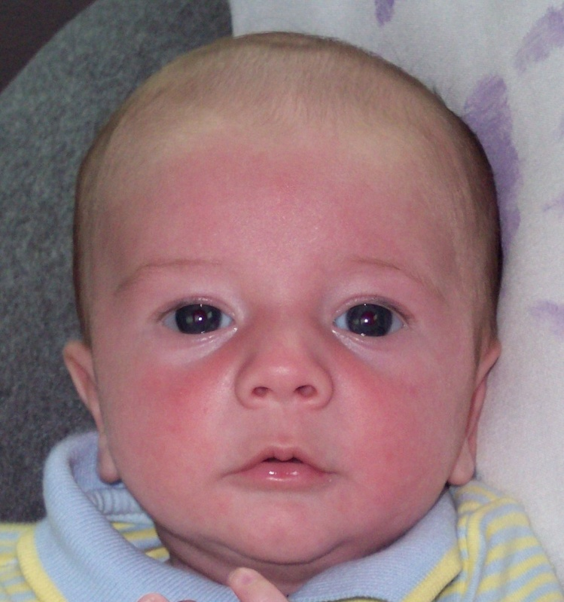
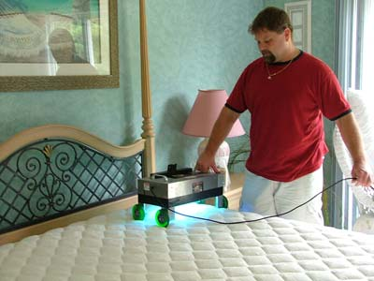
Ultraviolet Waves (UV) (λ = 100nm-10nm)
  enough energy to kill cells
  good to help our skin cells make Vitamin D
  bad because of skin cancer

Slide 15
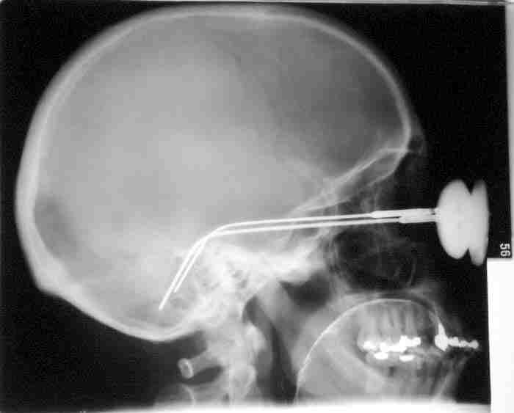
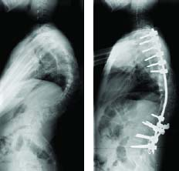
X-Rays (λ = 10nm-0.01nm)
  easily pass through many materials (skin, muscle, but not bone or lead)
  can mutate living cells

Slide 16
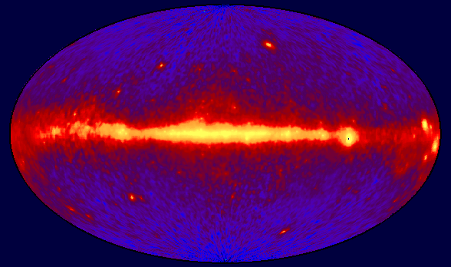
Gamma Rays (λ = .01nm - .000001nm)
  highest frequency and energy
  emitted from various sources (supernova explosions, the destruction of atoms, and radioactive materials)
  very high penetrating ability (even cement)
Your gamma-ray vision would peer into the hearts of solar flares, supernovae, neutron stars, black holes, and active galaxies.

Slide 17
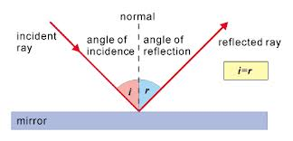
Law of Reflection
The angle of incidence is equal to the angle of reflection.

Slide 18
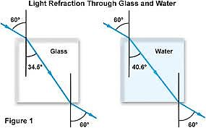
Refraction
Is a bending of light due to a change in medium.

