Slide 1
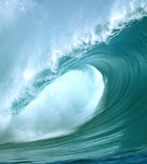
Wave Characteristics and Speed

Slide 2
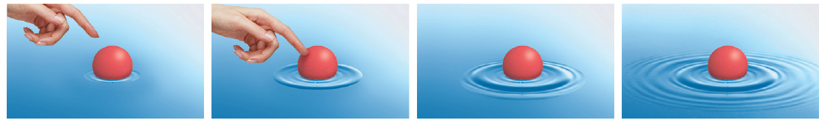
Characteristics
a traveling disturbance that carries energy through matter or space
matter moves horizontally or vertically just a little, while the wave energy moves horizontally a lot.
most get their energy by a vibration or an oscillation of a medium (what they are in)

Slide 3
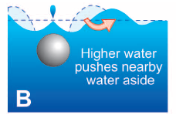
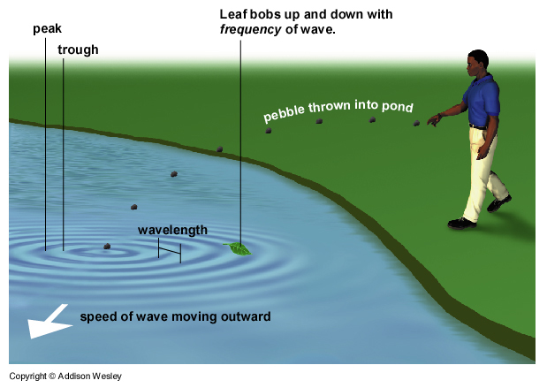

Slide 4
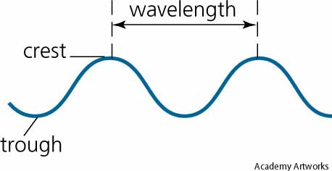
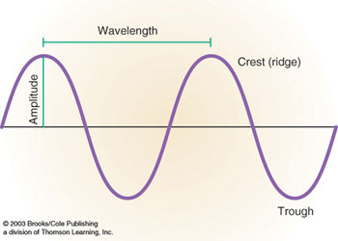
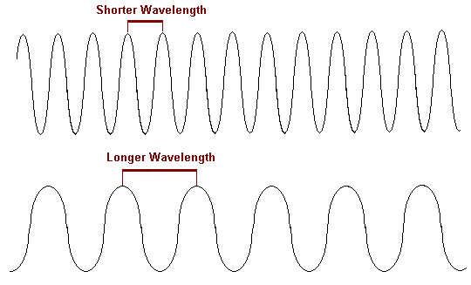
Parts of a Wave

Slide 5
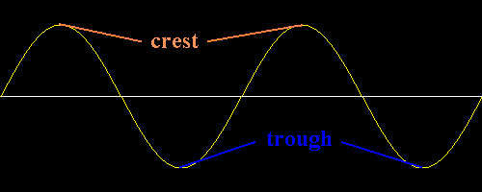
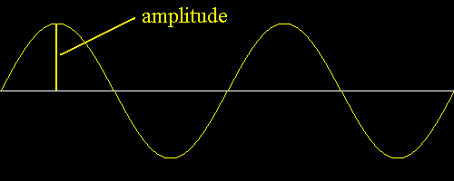
Crest
  highest point of the
  wave
Trough
  the lowest point of
  the wave
Amplitude
  how high or low the wave is
  measure from the x-axis (resting position) to the crest or trough
  as amplitude increase, so does the energy of the wave

Slide 6
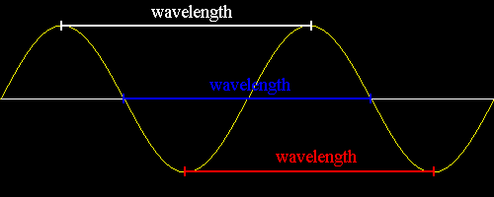
Wavelength
  the distance between two consecutive crests or troughs
  symbol is Greek letter lambda, λ

Slide 7
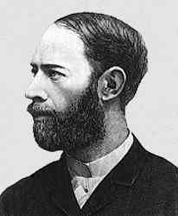
Frequency
  the number of complete waves per unit of time (normally seconds)
  count how many troughs or crests go by in one second
  unit of measurement is Hertz (Hz)
Wave frequency website

Slide 8
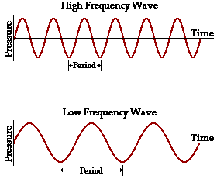
Wave Velocity (Speed)
determined by the frequency AND the wavelength
the speed of a wave depends upon the elasticity and density of the medium it is traveling through

Slide 9
Wave velocity formula
v = f(λ)
v = velocity (wave speed)
f = frequency (how many waves that
pass a point in a given time)
λ = wavelength

Slide 10
Which wave is faster if three wavelengths pass here in one second (3 Hz)?

Slide 11
Example problem
What is the speed of a wave with a frequency of 5 Hz and a wavelength of 3 meters?
given formula set up problem answer w/ unit of measurement
f = 5 Hz v = f(λ) 5Hz (3m) 15 m/s*
λ = 3 m
*could also put Hz(m)

Slide 12
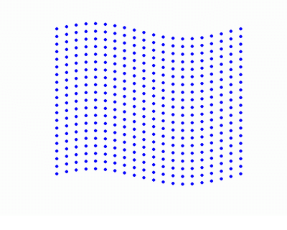
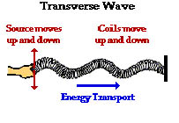
Types of Waves
  1. Transverse Waves
    the motion of the medium is perpendicular (right angles) to the direction the wave is moving
      “stuff in the wave moves up and down, while the wave moves left or right”

Slide 13
  2. Longitudinal Waves
    the motion of the medium is parallel to the direction the wave is moving
      “both the energy of the wave and the atoms are moving the same direction”
    also called compression waves because the medium is compressed (pushed together)
    the compressed area with more particles is called the compression
    the spread out area where there are fewer particles is called the rarefaction

Slide 14
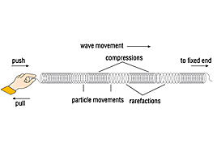


Slide 15
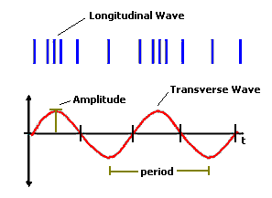

Slide 16
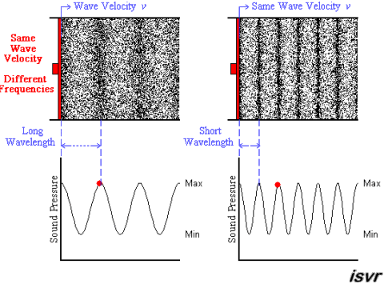

Slide 17
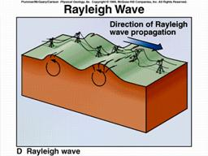
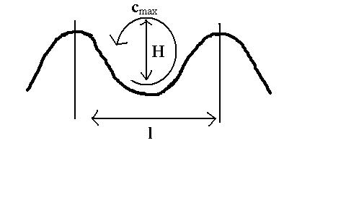
  3. Surface Waves
    a combination of longitudinal and transverse waves
    occurs in between two mediums like water and air
    the particles in the wave move in a circular path

Slide 18
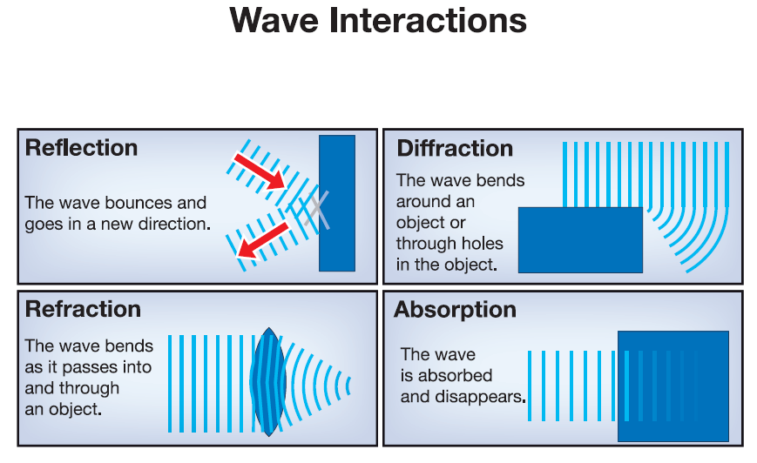
Behavior of Waves

Slide 19
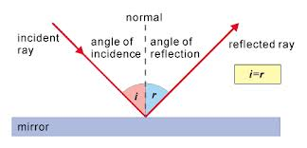
Law of Reflection
The angle of incidence is equal to the angle of reflection.

Slide 20
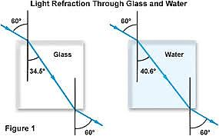
Refraction
Is a bending of light due to a change in medium.

Slide 21
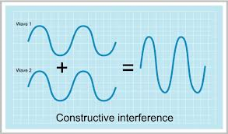
Types of Interference
Constructive
  when waves add up to produce a larger pulse or amplitude.
  “in phase”

Slide 22
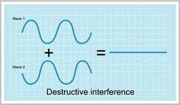
2. Destructive
waves add up to make a wave with smaller or zero amplitude.
“out of phase”

