Slide 1

Magnetism

Slide 2
“e-bomb” video (1:19)
  http://www.howstuffworks.com/electromagnet.htm

Slide 3
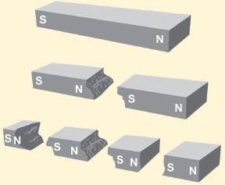
all magnets have two opposite magnetic poles, called the north pole and south pole

Slide 4
atoms can act like tiny magnets
permanent magnets have their atoms aligned creating the magnetic forces
atoms in non-magnetic materials, like plastic, are not free to move or change their magnetic orientation

Slide 5
iron filings demo here

Slide 6
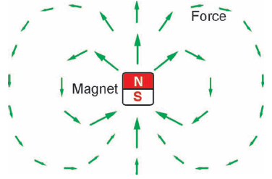
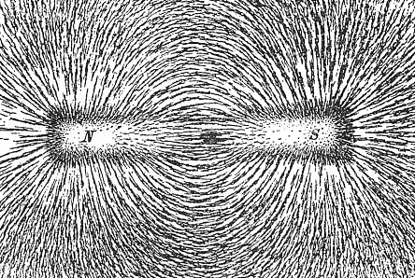
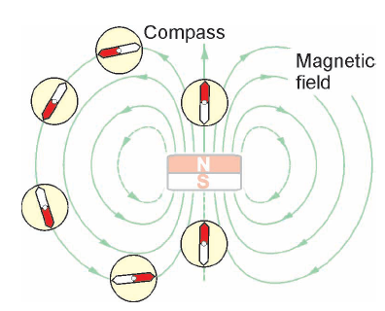
a compass or iron filings are a great way to “see” magnetic field lines

Slide 7
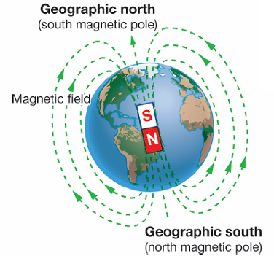
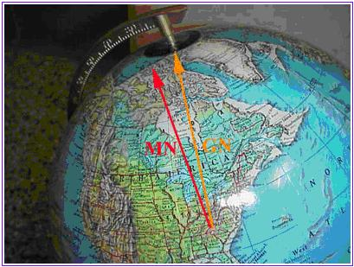
Earth has a magnetic field that comes from the core of the planet
  magnetic North and geographic North are ~1,000 km apart
  poles reverse about every .5 million years

Slide 8
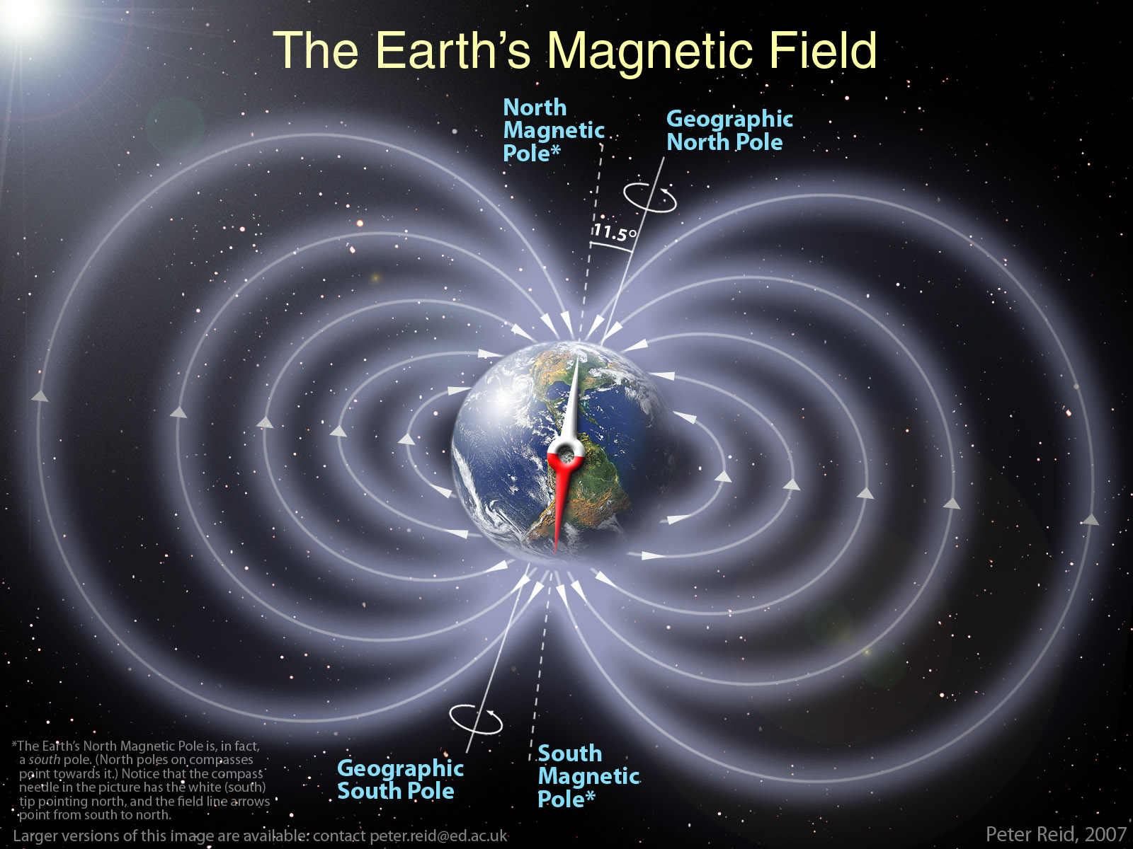

Slide 9
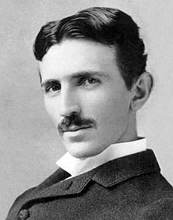
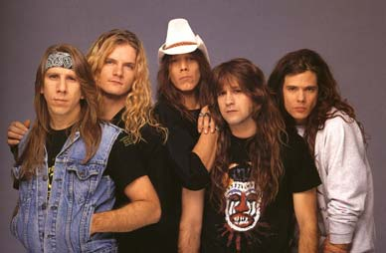
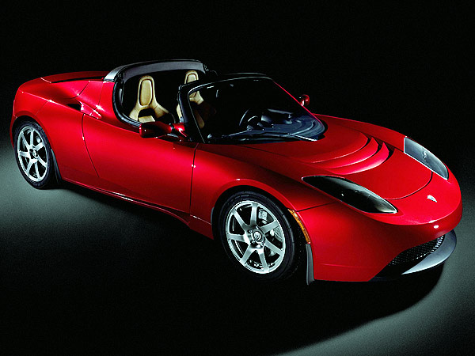
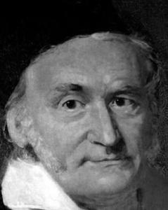
gauss is the unit of measurement
for magnetism, so is tesla
  10⁻⁹–10⁻⁸ gauss: the human brain magnetic field
  .5 gauss: Earth's magnetic field on its surface
  50 gauss: typical refrigerator magnet
  100 gauss: a small iron magnet
  15,000-30,000 gauss: a medical magnetic resonance imaging electromagnet (MRI)

Slide 10
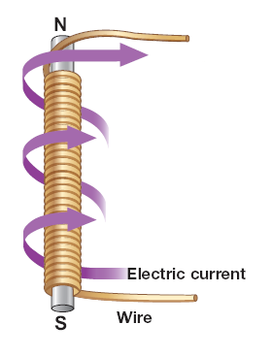
Electromagnets
created when conductive wire, usually copper, is wrapped around a piece of metal
can change the strength AND turn on and off

Slide 11
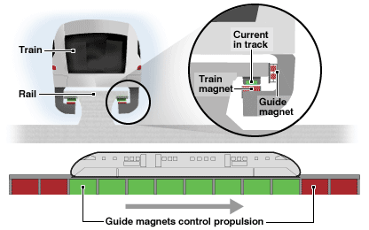
Applications/uses
  maglev trains
    http://dsc.discovery.com/videos/extreme-engineering-season-1-shorts-maglev-train.html

Slide 12
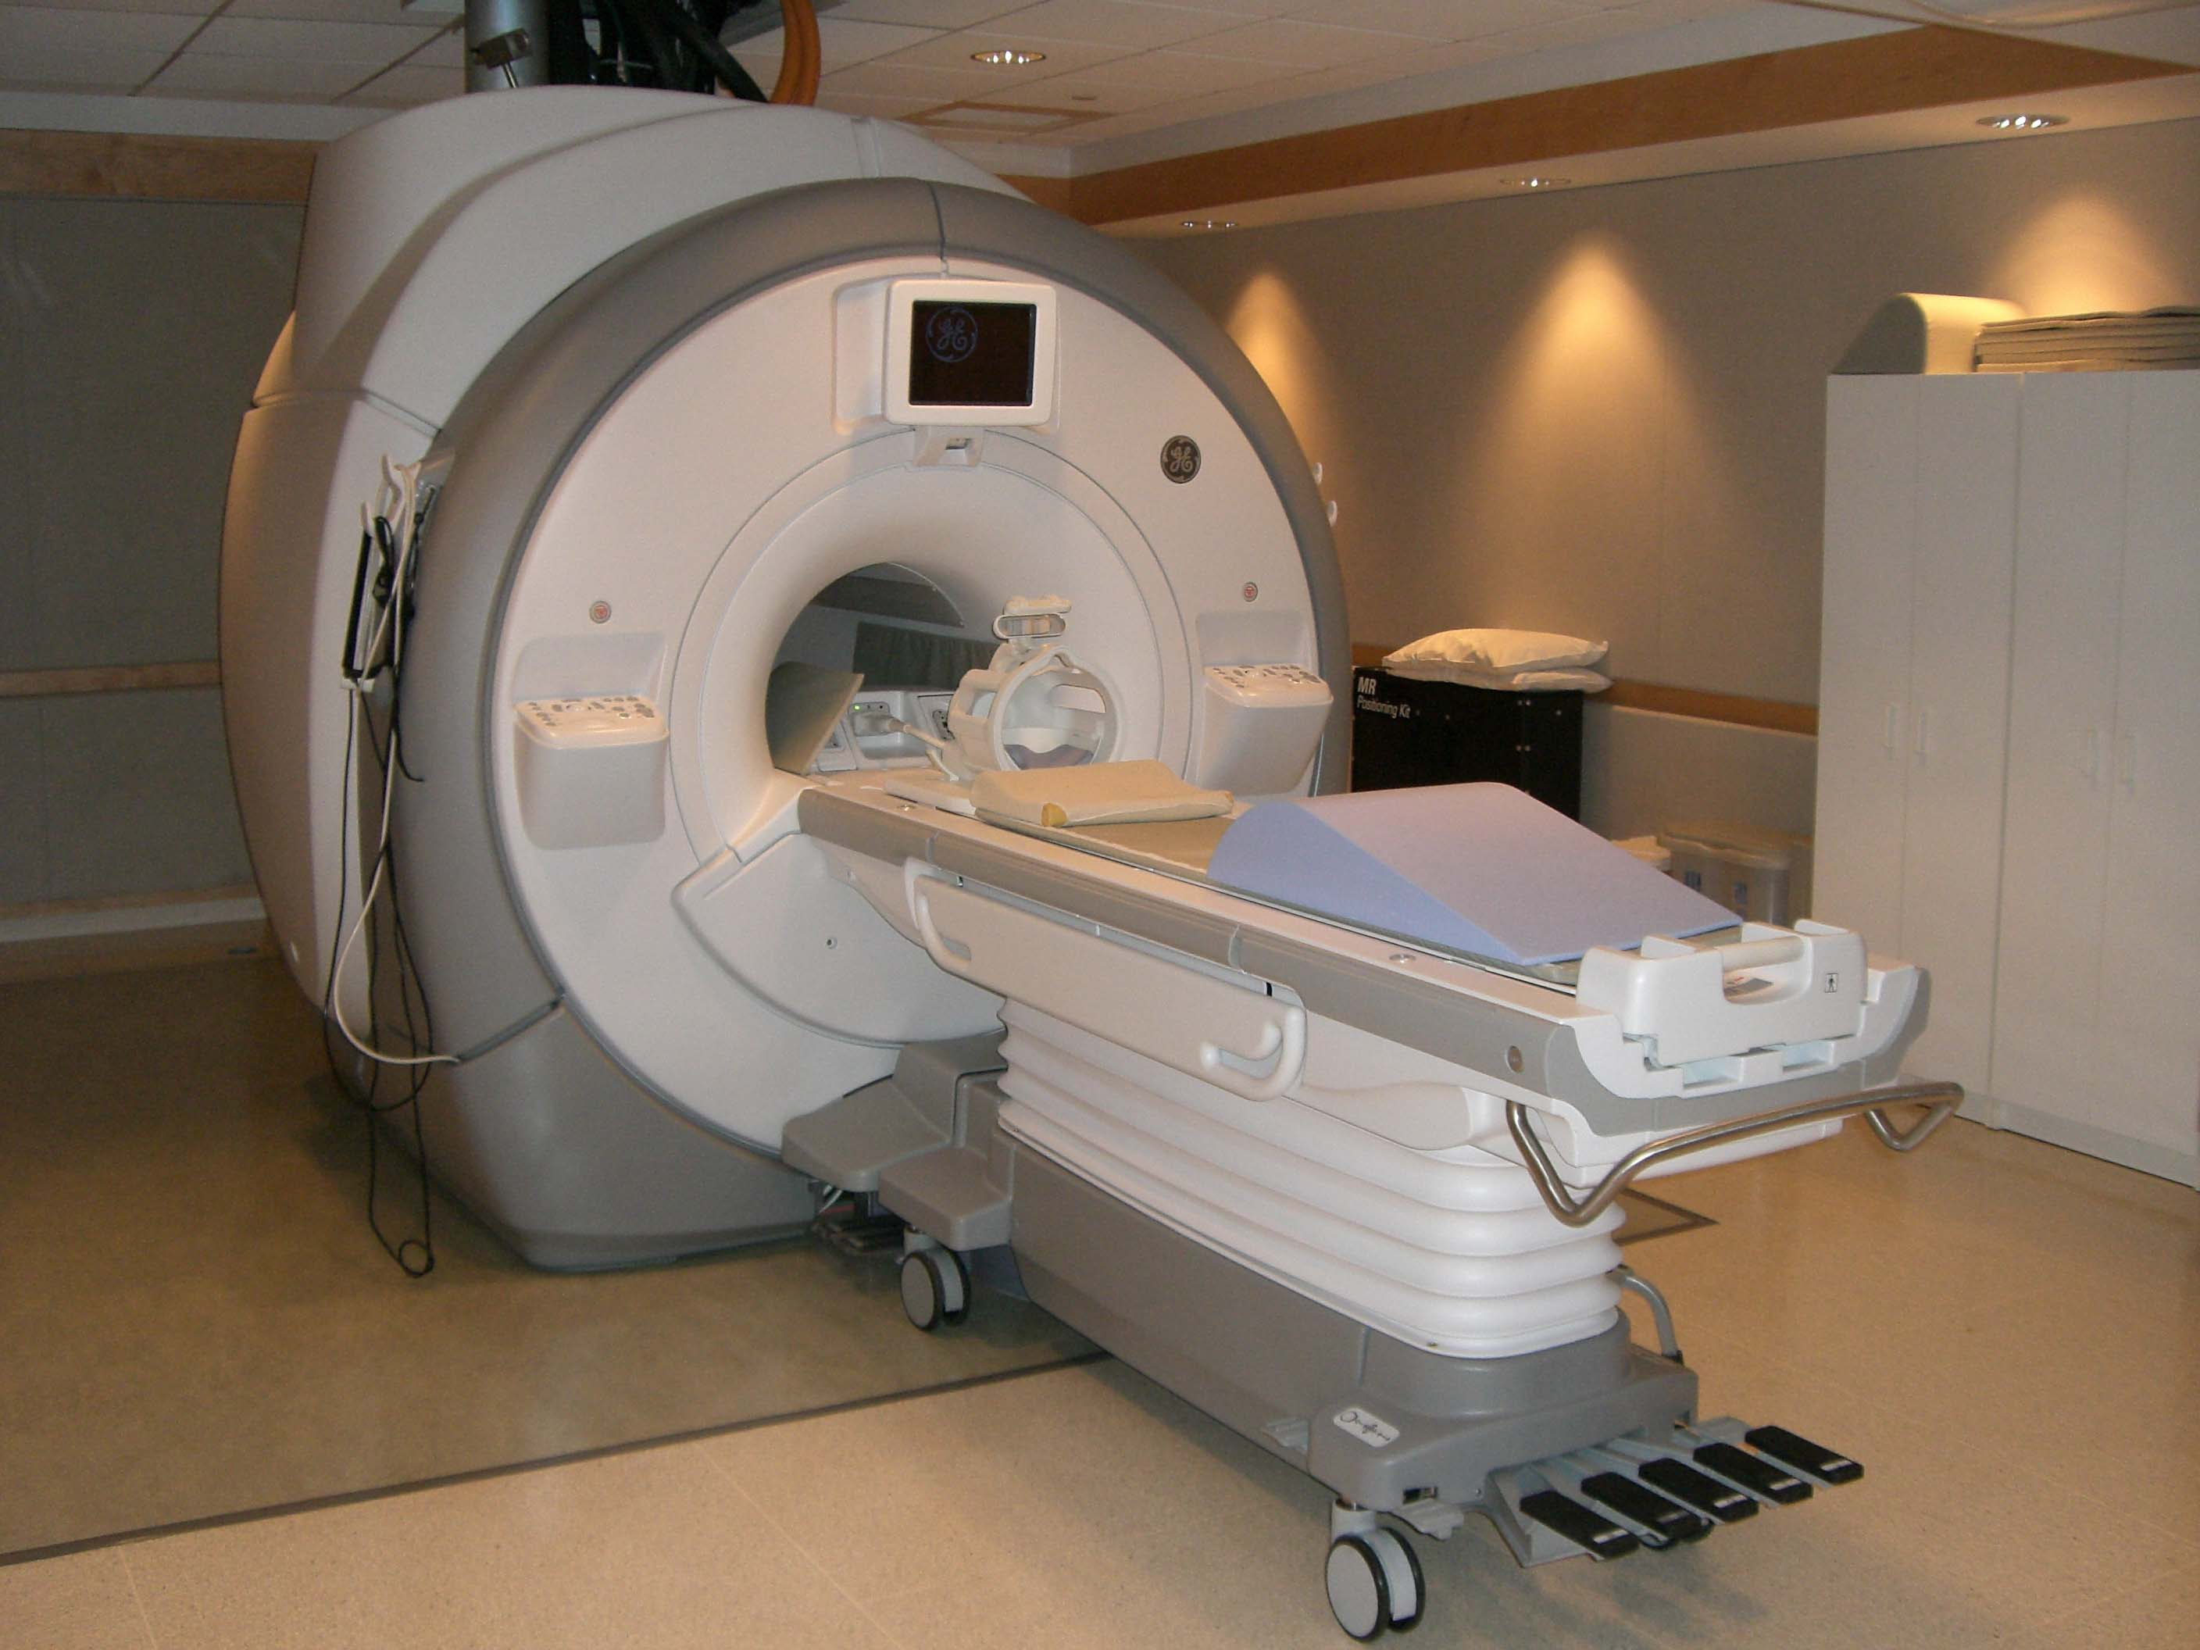
MRI machines

Slide 13
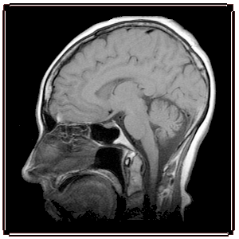
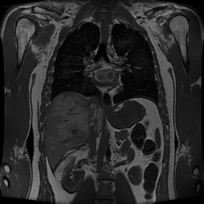

Slide 14
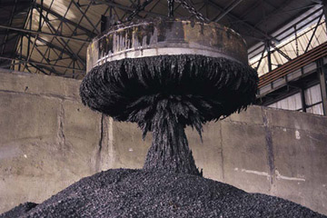
  construction/wrecking yards

Slide 15
electric motors
  permanent and electromagnets work together in order to convert electrical energy into motion
  the outside electromagnet reverses back and forth to keep the permanent magnets moving

Slide 16
generators
  opposite of electric motors
    transforms motion into electrical energy
  a moving magnet can produce an electric current in a coil of wire
Phet
http://phet.colorado.edu/en/simulations/category/physics/electricity-magnets-and-circuits

