Slide 1
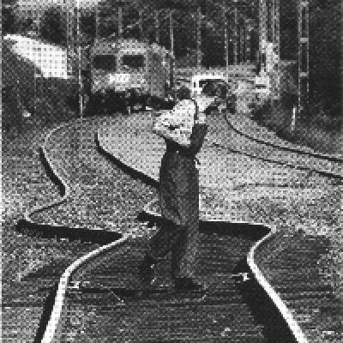
Heat and Temperature

Slide 2
Heat
a flow of thermal energy
always goes from hot to cold
cold is simply the absence of heat
the more substance, the more heat energy
measured in calories (cal) or joules (J)
  a calorie is amount of energy needed to raise one gram of water one degree Celsius

Slide 3
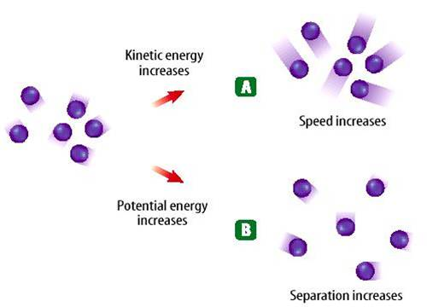
Thermal Energy – the total of all the kinetic and potential energy of all the particles in a substance.

Slide 4
Thermal energy relationships
a. As temperature increases, so does thermal energy (because the kinetic energy of the particles increased).
b. Even if the temperature doesn’t change, the thermal energy in a more massive substance is higher (because it is a total measure of energy).

Slide 5
Temperature
the measure of the average KE of atoms
measures how hot or cold something is
does not depend how much of the substance is present
a thermometer measures temperature
  Fahrenheit was made by the lowest temperature attainable under laboratory conditions in the 1700’s and this was set at 0ºF
  Celsius assigns 0ºC to the freezing point and 100ºC to the boiling point of water respectively
  Kelvin assigns 0 K to absolute zero

Slide 6
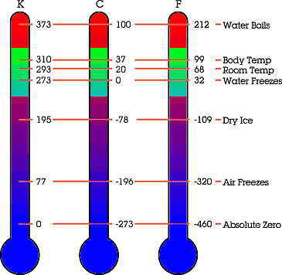

Slide 7
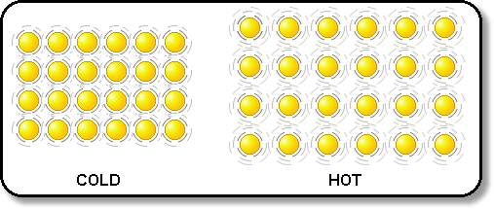
Thermal Expansion
most substances expand when heated (and shrink when cooled)
the heat causes atoms to move faster and farther away from each other, therefore taking up more space
solids- expand a little (atoms are fixed in place, can’t expand much)

Slide 8
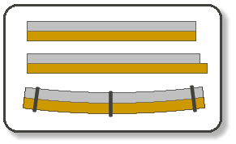
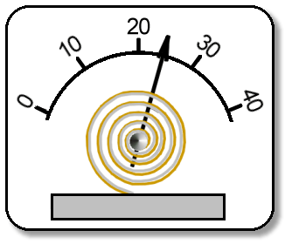

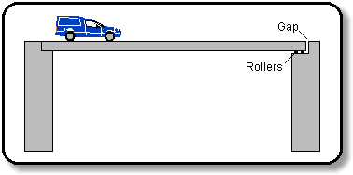

Slide 9
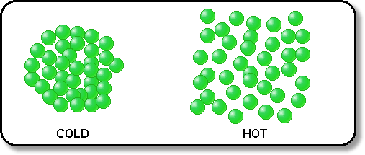
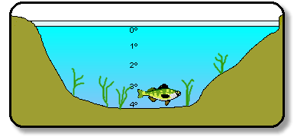
liquids- expand a little (atoms are still right next to each other)
water is an exception to the rule when very cold
  it is the densest at 4ºC
  as it gets colder than 4ºC, it expands and finally freezes at 0ºC
  ice floats

Slide 10
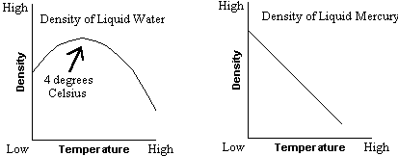
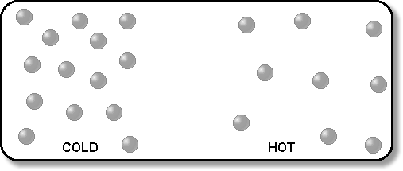
gases- expand a lot (atoms are free to move around every where) Ex: Hot air rises

Slide 11
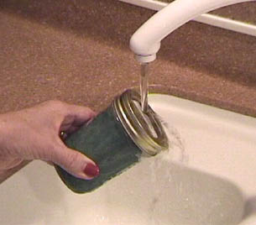

Slide 12
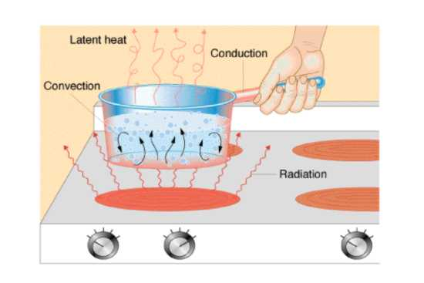
Heat Transfer
the movement of heat from a warmer object to a cooler one
3 ways to transfer heat
  Conduction
  Convection
  Thermal

Slide 13
Three ways to transfer heat:
  Conduction
    heat is transferred by the direct contact of atoms
    when fast moving atoms collide with slow moving atoms, they begin to move faster and therefore heat up
    works best in solids, but also liquids and gases
    conductors are materials that conduct heat well
      metals (Cu, Al, and Fe)
    insulators are substances that do NOT conduct heat well
      glass, wood, rubber, air

Slide 14
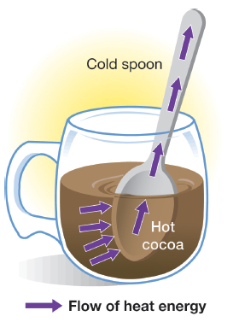

Slide 15
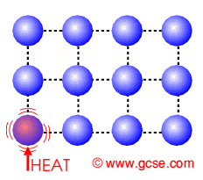

Slide 16
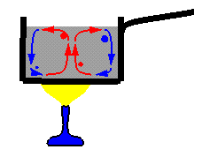
  Convection
    hot atoms begin to move faster, expand, becomes less dense, rise, and take the heat with them
    works in liquids and gases
    the warm air rising and the cool air sinking produce convection currents in the atmosphere and oceans

Slide 17
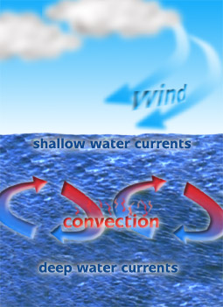
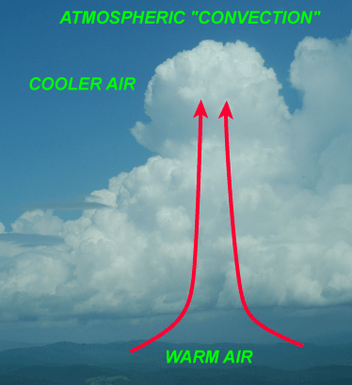

Slide 19
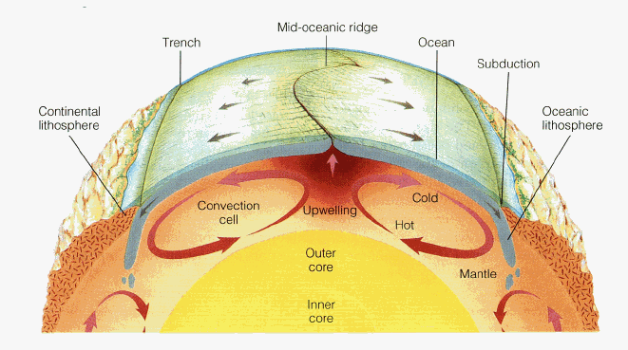

Slide 20
  Radiation
    heat transferred through space by small particles called photons that travel in a wave
    all objects emits thermal radiation
    how the sun heats the earth

Slide 21
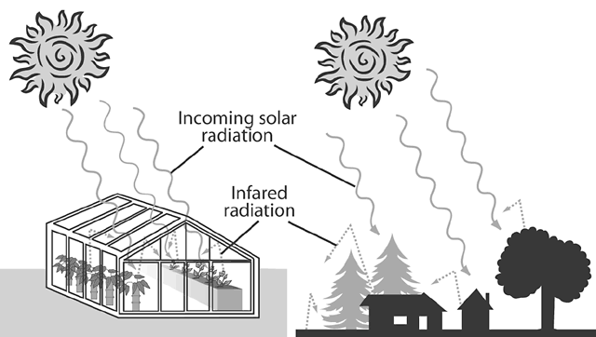

Slide 22
Heat and Phase Changes
changing a substance from one phase, or state, to another requires the addition or subtraction of heat
heat of fusion – amount of heat needed to melt 1 gram of a substance
heat of vaporization – amount of heat needed to vaporize (boil or evaporate) 1 gram of a substance

Slide 23
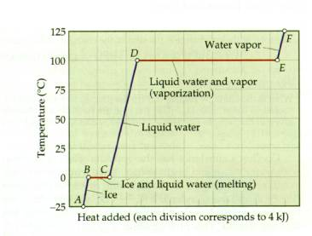
HEAT OF VAPORIZATION
HEAT OF FUSION

Slide 24

Specific Heat
Some things heat up or cool down faster than others.
Land heats up and cools down faster than water
Land heats up and cools down faster than water

Slide 25
Specific heat is the amount of heat required to raise the temperature of 1 kg of a material by one degree (C or K).
1) C water = 4184 J / kg C
2) C sand = 664 J / kg C
This is why land heats up quickly during the day and cools quickly at night and why water takes longer.

Slide 26
How to calculate changes in thermal energy
Q = m x T x Cp
Q = change in thermal energy
m = mass of substance
T = change in temperature (Tf – Ti)
Cp = specific heat of substance

Slide 27
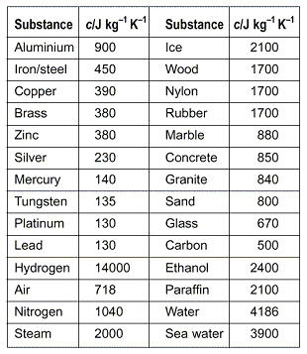
Specific Heat
the ability of a substance to absorb and retain heat
the number of calories needed to raise one gram of a substance one degree Celsius
different substances heat up quicker than others

Slide 28
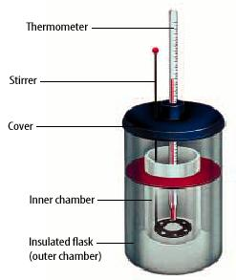
A calorimeter is used to help measure the specific heat of a substance.
Knowing its Q value, its mass, and its T, its Cp can be calculated

