Slide 1
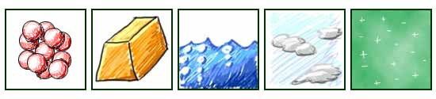
Phases and Changes in Matter

Slide 2

when they are close together, molecules are attracted through intermolecular forces

Slide 3
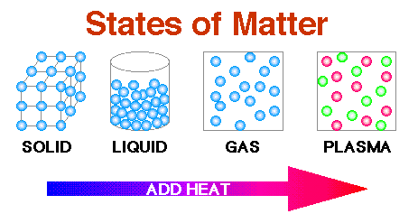
however, higher temperatures can affect these forces
  if temperature is high enough…
    molecules may fly apart and may have a liquid, gas, or plasma
  if forces between the molecules is strong and temperatures low…
    molecules clump tightly together and you may have a liquid or solid

Slide 4
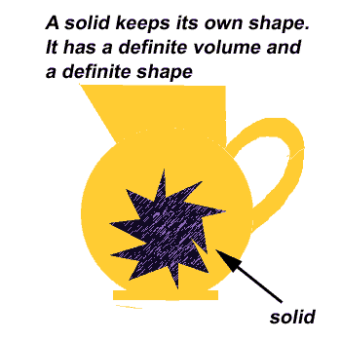
Five phases of matter
Solids
  have a definite shape and definite volume
  atoms can’t move out of place
  often arranged in crystals that are atoms arranged in regular, repeating patterns.
Notes:
Melt aluminum. Show using the document camera.

Slide 6
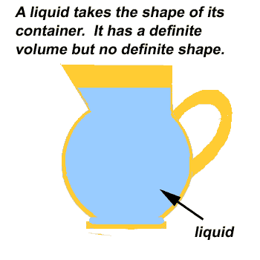
Liquids
  do NOT have a definite shape
    take on the shape of the
    container they are in
  have a definite volume
  atoms are very close together and are free to move
    viscosity is the resistance of a liquid to move or flow

Slide 8
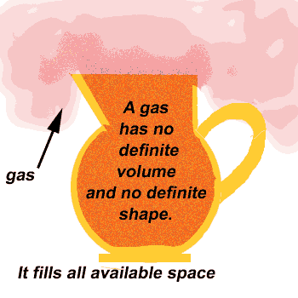
Gases
  does NOT have a definite shape or a definite volume
  atoms are often very far apart from each other but they can be pushed close together

Slide 9
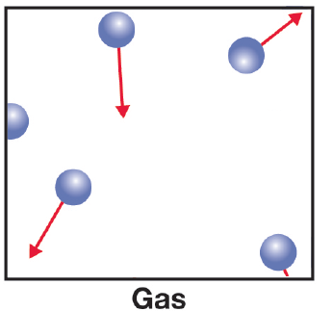

Slide 10
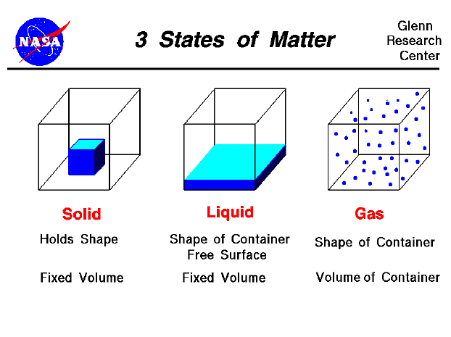

Slide 11
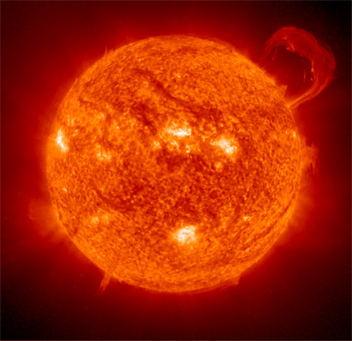
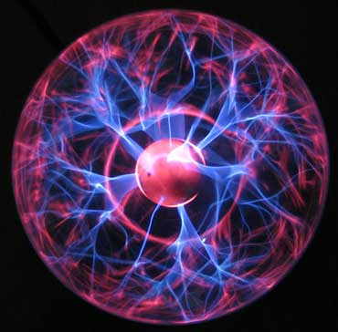

Plasma
  most common phase of matter in the universe
    example: sun, a lightning strike, neon signs and fluorescent bulbs
  atoms split into positively charged fragments called ions and negatively charged free electrons

Slide 12
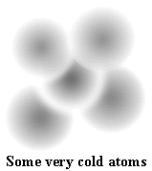
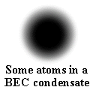
Bose Einstein Condensate (be aware it exists; do not have to know anything about it)
  all the atoms act absolutely identical to each other
  at incredibly low temperatures (less than millionths of a degree above absolute zero) atoms lose their individual identities and form into a single blob
  they act as super-atoms or groups of atoms that behave as one.
http://www.colorado.edu/physics/2000/bec/what_is_it.html

Slide 13
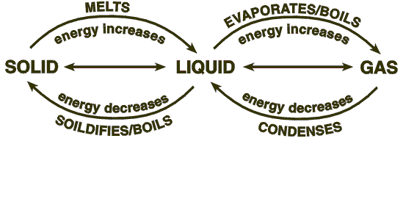
Phase Changes

Slide 14
substances can change states/phases by:
  adding or taking away energy (heating or cooling down)
  increasing or decreasing pressure
there are no chemical changes and therefore no new substances are formed

Slide 15
LIQUID
vaporization*
*evaporation
*boiling
melting
condensation
freezing
deposition
GAS
SOLID
sublimation
= taking away heat (cooling down)
= adding heat (heating up)

Slide 16
Boiling vs. Evaporation-- in more detail
Share-Pair
Boiling
  happens above the boiling point of the liquid at a given pressure
  occurs throughout the liquid
Evaporation
  happens below the boiling point of the liquid
  only occurs at the surface of the liquid

Slide 17
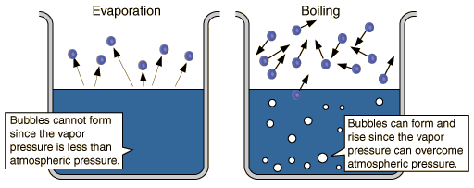

Slide 18
